Slide 1
PPT模板下载：www.1ppt.com/moban/ 行业PPT模板：www.1ppt.com/hangye/
节日PPT模板：www.1ppt.com/jieri/ PPT素材下载：www.1ppt.com/sucai/
PPT背景图片：www.1ppt.com/beijing/ PPT图表下载：www.1ppt.com/tubiao/
优秀PPT下载：www.1ppt.com/xiazai/ PPT教程： www.1ppt.com/powerpoint/
Word教程： www.1ppt.com/word/ Excel教程：www.1ppt.com/excel/
资料下载：www.1ppt.com/ziliao/ PPT课件下载：www.1ppt.com/kejian/
范文下载：www.1ppt.com/fanwen/ 试卷下载：www.1ppt.com/shiti/
教案下载：www.1ppt.com/jiaoan/ PPT论坛：www.1ppt.cn
Towards Big Graph Processing: Applications, Challenges, and Advances
Xuemin Lin
UNSW

Slide 2
What is a graph ?
Vertices: a collection of entities
Edges: connections between vertices
v1
v5
v6
v3
v7
v2
v8
v9
v4

Slide 3
Introduction of
Graphs and Classic Problems

Slide 4

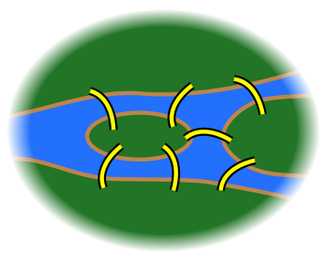
1. Seven Bridges of Königsberg
Leonhard Euler in 1735:
find a roundtrip through the city to cross each bridge once and only once
earliest (published) work on networks/graphs

Slide 5
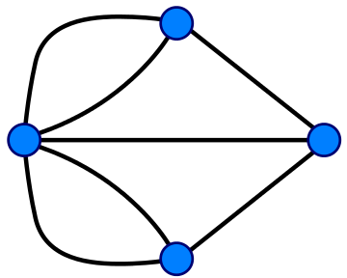
1. Seven Bridges of Königsberg(cont.)
Abstraction:
replaced each land mass with an abstract "vertex" or node, and each bridge with an abstract connection, an "edge”
Showed that this problem has no solution.
Euler Tour:
necessary and sufficient conditions for the walk of the desired form: connected and all vertices with even degrees.

Slide 6
Graphs
Definition:
A Graph is a collection of nodes joined by edges.
G=(V,E)
V is a set of vertices, u, v in V are vertices
E is a set of edges, (u,v) in E is an edge.
(u,v)

Slide 7
Edges
Undirected edges
u–v: (u,v)=(v,u)
e.g., u and v like each other; u and v are co-authors
Directed edges(arcs)
u→v: (u, v) != (v, u)
(u, v) is an in-link (in-edge) of v, and an out-link (out-edge) of u.
e.g., u likes v; u is the father of v.
Other attributes
weight (e.g. frequency of communication) – w(u, v)
rank (e.g., best friend, second best friend, ...)
type (e.g., friend, co-worker, activates, inhibits, ...)

Slide 8
Vertices
Degree
d(v): the number of edges connected to a vertex
In degree: number of incoming edges of a vertex
Out degree: number of outgoing edges of a vertex
If edges are weighted, the degree, in degree, out degree are the total weights of edges, incoming edges, outgoing edges of a vertex.
Other attributes: – Weight: (e.g., importance, authority of a person)
– Type: (e.g., advisor, student, old people)
– Label: (e.g., name)

Slide 9
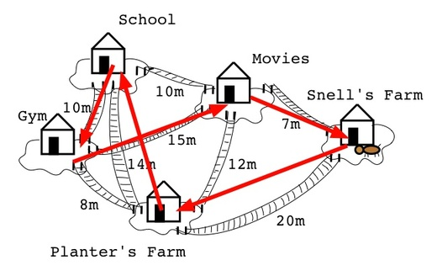
2. Travelling salesman
Problem:
Given a list of cities and the distances between each pair of cities, find the shortest route that visits each city exactly once and returns to the origin city.
In the theory of computational complexity, the TSP belongs to the class of NP-hard problems.
Thus, it is unlikely that the worst-case running time for any algorithm for the TSP is in PTIME.

Slide 10
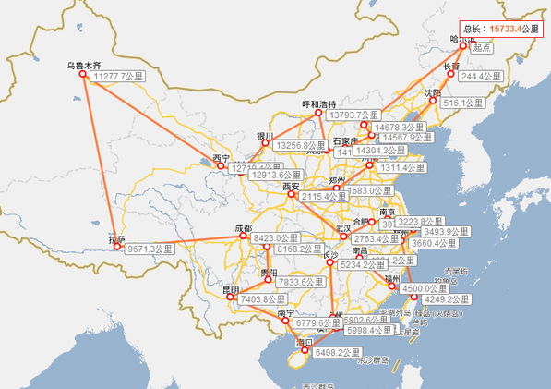
2. Travelling salesman (cont.)
Heuristic Solutions:
Constructive heuristics: Nearest-neighbors (greedy), spanning tree, bitonic tour, etc.
for extremely large problems (millions of cities), within a reasonable time which are with a high probability just 2–3% away from the optimal solution
Widely used in several applications:
planning, logistics
the manufacture of microchips.
DNA sequencing, etc.

Slide 11
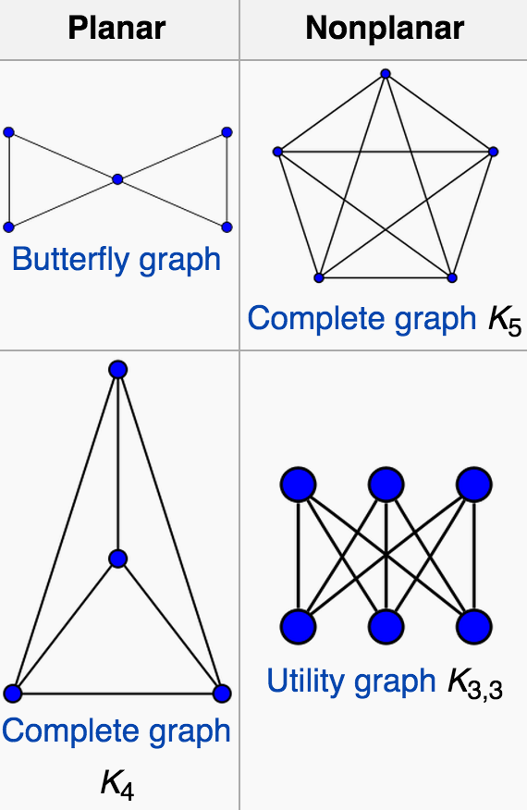
3. Planar graph
Definition: can be embedded in the plane
i.e., it can be drawn on the plane in such a way that its edges intersect only at their endpoints.
Determination:
does not contain a subgraph that is a subdivision of K5 (the complete graph on five vertices) or K3,3((complete bipartite graph on six vertices)

Slide 12
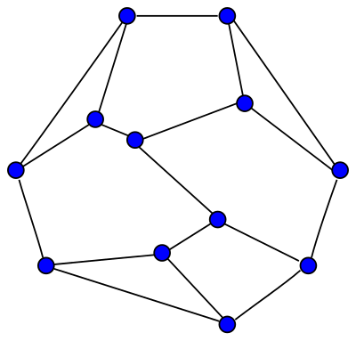
4. Euler’s Formula
Euler’s Formula:
if a finite, connected, planar graph is drawn in the plane without any edge intersections
v − e + f = 2. (v is the number of vertices, e is the number of edges and f is the number of faces)

Slide 13
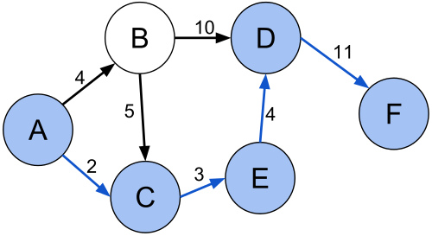
5. Shortest Path
a.k.a. Geodesic paths:
finding a path between two vertices (or nodes) in a graph such that the sum of the weights of its constituent edges is minimized.
Solution:
Single Source: Dijkstra
All Pair: Floyd-Warshall.

Slide 14
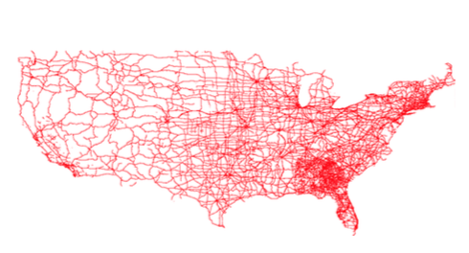
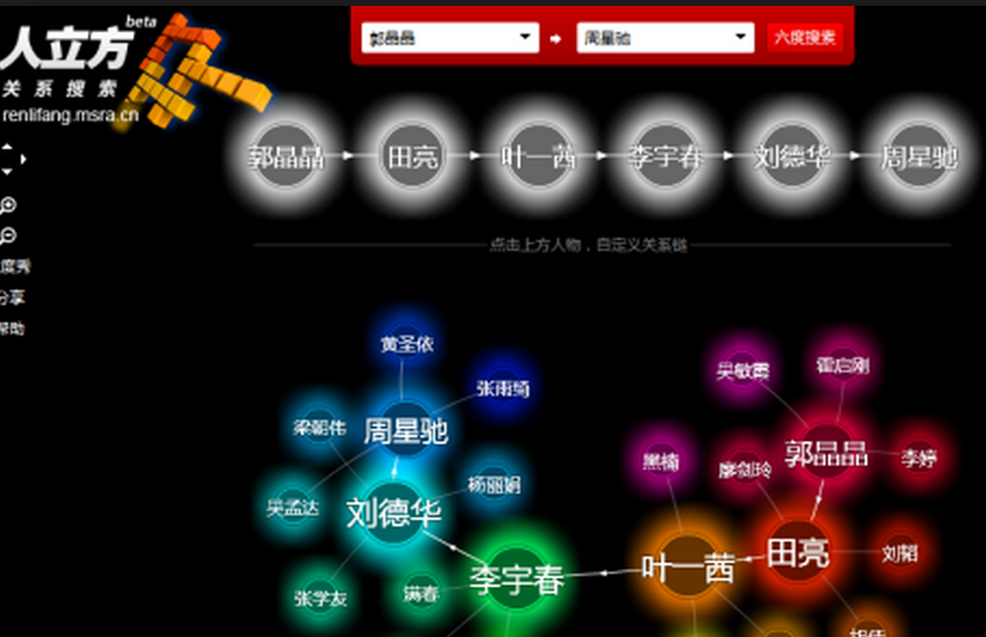
5. Shortest Path(cont.)
Applications:
Road Network Navigation
n-Degree Separation in Social Networks
Six Degree of Separation
http://entitycube.research.microsoft.com/6dumapsvg.aspx

Slide 15
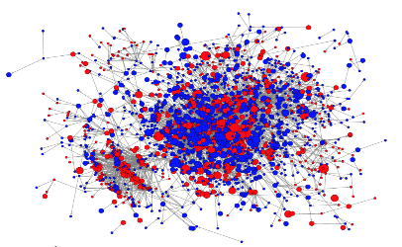
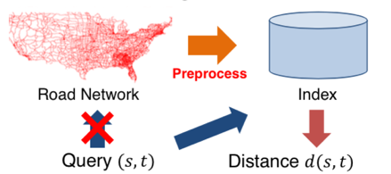
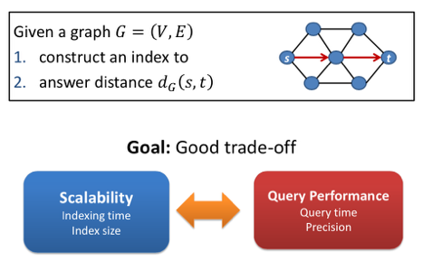
5. Shortest Path(cont.)
How to fast get shortest path between two nodes in a large graph?
Pre-computed small structure to maintain distances.
Distance Oracle:
Hop cover for each nodes’ reachable node list
Intersect of two lists.
Landmark based global summary structure.
Tree traversal.

Slide 16
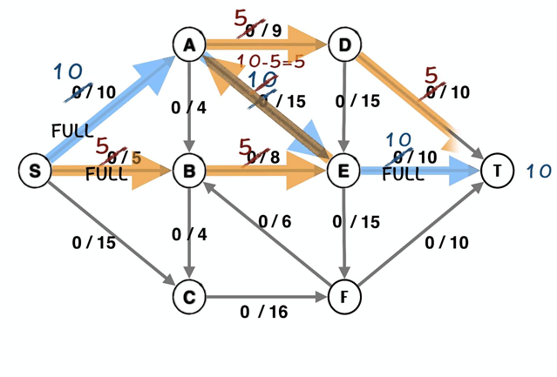
6. Max-Flow
Problem:
finding a feasible flow through a single-source, single-sink flow network that is maximum.
Applications:
Airline/pipeline/network scheduling
Circulation-demand/logistics planning
Social network Sybil/Spammer detection

Slide 17
6. Max-Flow (cont.)
Common Solutions:
Linear Programming.
Ford-Fulkerson: O(mn)
Recent result: close to O (m)

Slide 18
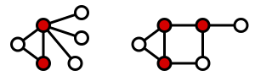
7. Vertex Cover
Problem:
A vertex-cover of an undirected graph G=(V,E) is a subset V’ of V, for edge (u,v) in G, u or v is in V’.
Minimum Vertex Cover:
NP-hard optimization problem.
Solution:
Approximation algorithm:
Repeatedly taking both endpoints of an edge into the vertex cover and remove.
Maximum Matching

Slide 19

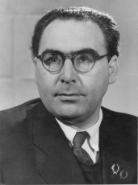
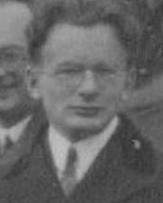
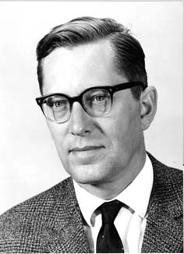
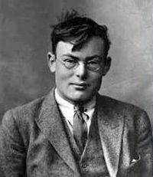
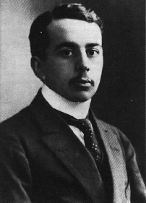
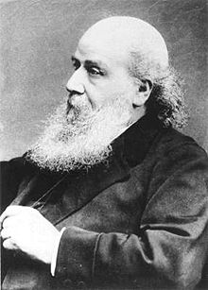
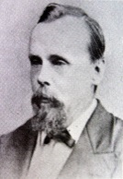
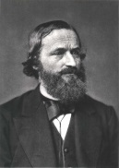
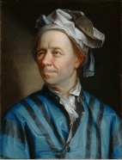
2003… Current
1969
Graph DB and Big Graph
1959
1959
Heinrich Heesch
Compute-aided-proof of 4-color theorem.
……
1941
De Bruijn
De Bruijin Sequence
Erdos, Renyi and Gilbert
…Random Graph Model
1936
Ramsey and Turán
Ramsey Number
1878
Dénes Kőnig
Graph Theory Textbook
1852
……
1845
Francis Guthrie
Four Color Theory
1736
Gustav
Kirchoff
Number of spanning trees
Leonard Euler Seven Bridges of Konisberg

Slide 20
Applications
Iterative
Pagerank
Shortest Path
K-hop
Degree correlation
Label Propagation
Community Detection
PPR
Structural Discovery
Cluster Coefficient
Triangle Courting
Centrality
Connected Component
Dense Subgraph (e.g. K-core, K-Truss)
Others
Link prediction
Transport Model （IC，LT model）
Maximal Influence
Node2vec
Applications
Services
Algorithms
Link Analysis
（relevance）
Insurance
Fake ID
Sensitive User
Fraudster
Team-Fraud
Relation Tracking
…
Relations
Degree/Neighbors
（structural）
Transportion
Advertising
Routings
Distance/Path
（reachability）
Routing
Spatial-Temporal Analysis
…
Real-time Recommendation
Forum selling
Community Detection
…
Community Detection
Social Network
Groups
propagation
Personal Value
Friend Recommend
Community and Organisation Analysis
…
Node mapping
（Embedding）
Features

Slide 21
Outline
Applications
Graph Matching
Cohesive Subgraphs
Graph Similarity and Clustering
Distributed Graph Computation
Other Graph Problems
Industry Collaborations

Slide 22
Some Examples
Fraud Detection
Product Recommendation
Retail Services
Investment Analysis
Product Lifecycle Management
Anti Money Laundering
Cyber Security
…….

Slide 23
Fraud Detection: First-Party Bank Fraud
Typical Scenario
A group of two or more people organize into a fraud ring;
The ring shares a subset of real contact, combining them to create a number of synthetic identities;
Ring members open accounts using these synthetic identities;
New accounts are added to the original ones (e.g. credit cards);
The accounts are used normally, with regular purchases and timely payments;
Banks increase the revolving credit lines over time, due to the observed responsible credit behaviour;
One day the ring “busts out”, coordinating their activity, maxing out all of their credit lines, and disappearing.

Slide 24
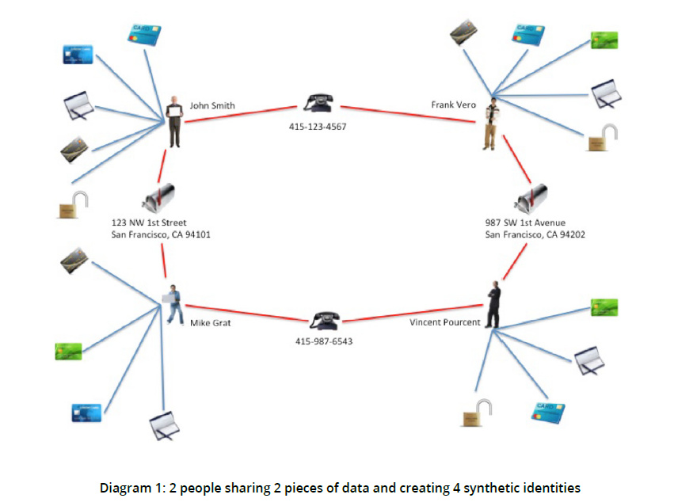
Fraud Detection: First-Party Bank Fraud

Slide 25
Fraud Detection: Insurance Fraud
Background:
Fraudsters claim the insurance money via faking or exaggerating injury, damage etc.
The impact of fraud on the insurance industry is estimated to be $80 billion annually in the US.
In the UK, insurers estimate that bogus whiplash claims add $144 per year to each driver’s policy

Slide 26
Fraud Detection: Insurance Fraud
Typical Scenario
rings of fraudsters work together to stage fake car accidents and claim soft tissue injuries.
“Paper collisions”, with fake drivers, fake passengers, fake pedestrians and even fake witnesses.
Roles
Providers
Doctors: diagnose false injuries
Lawyers: file fraudulent claims
Body shops: misrepresent damage to cars
Participants
Drivers, Passengers, Pedestrians and Witnesses

Slide 27
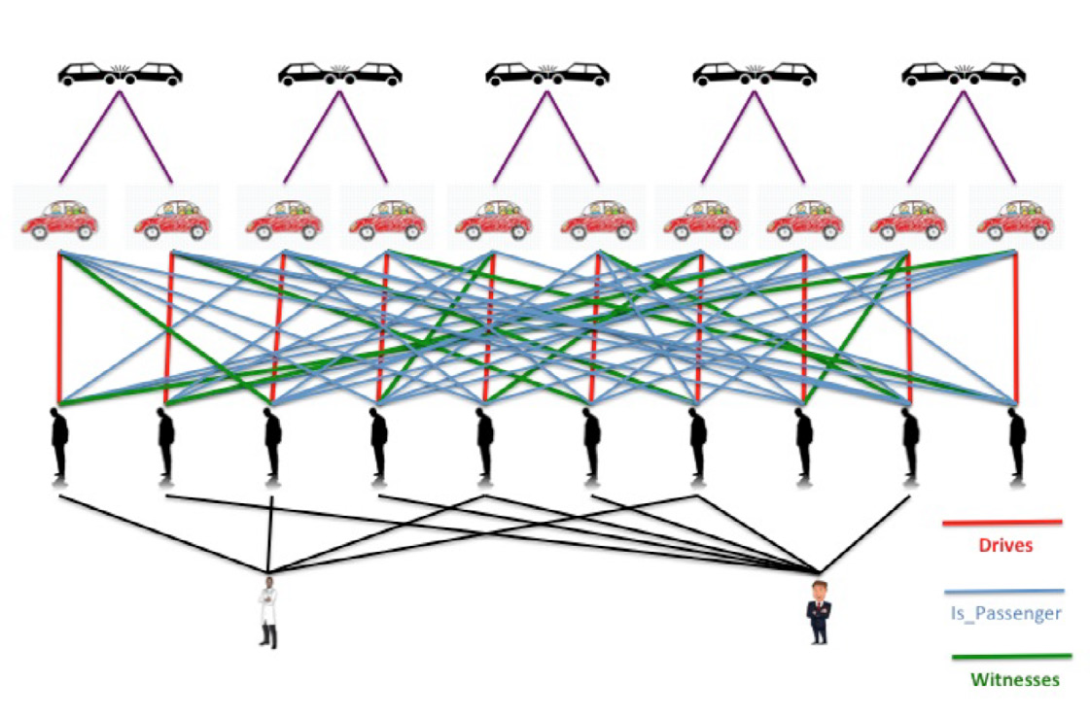
Fraud Detection: Insurance Fraud
No Possible to Join

Slide 28
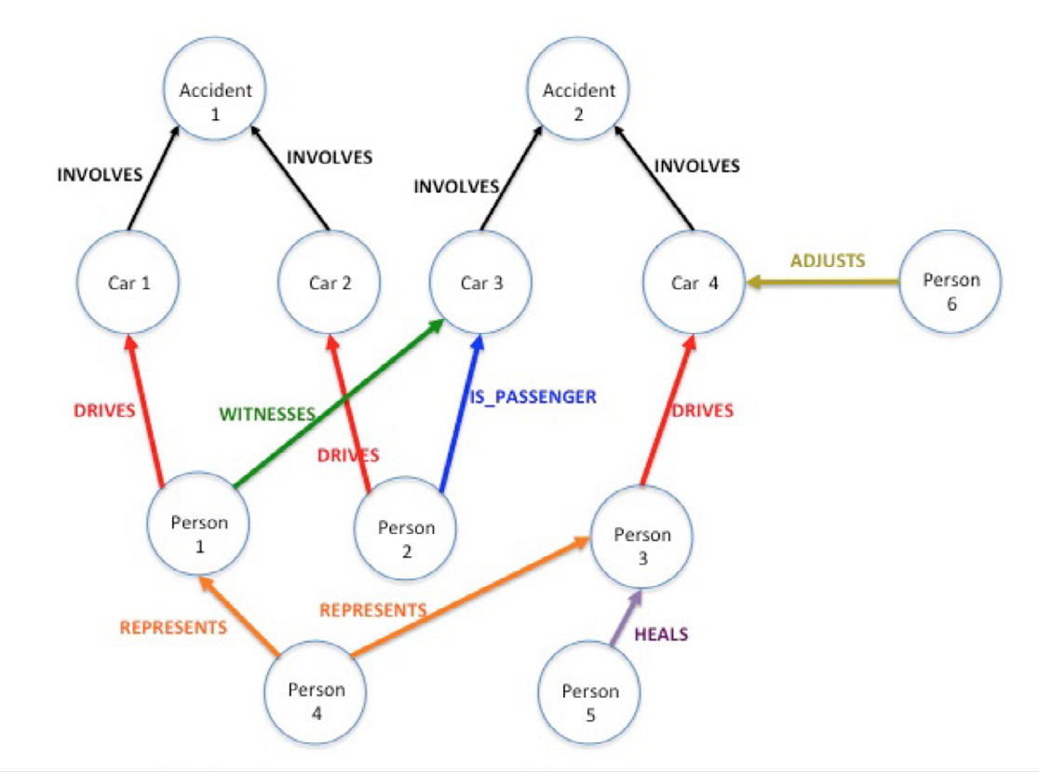
Fraud Detection: Insurance Fraud
The entities involved in one of the rings.

Slide 29
Fraud Detection: Some Insights
The data is grow so big and so complex that it is impossible to go with relation database.
Graph database can naturally model the complex relations of data.
The fraud detection can often reduce to the mining of certain patterns:
Rings (in the previous two examples)
Bi-cliques
More others.

Slide 30
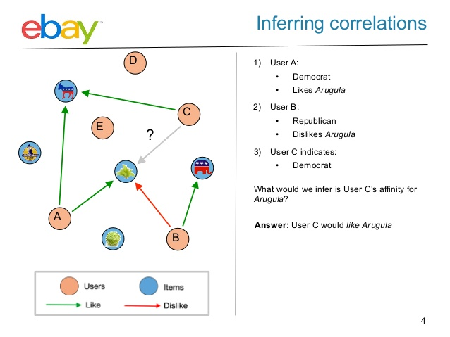
Product Recommendation
Goal
Online shopping, financial product recommendation
Solution
Put customers, preferences, purchases, products and locations etc. into a graph model
Uses connections to make product recommendations
Challenge
Serve many millions of customers and products: scalability & efficiency

Slide 31
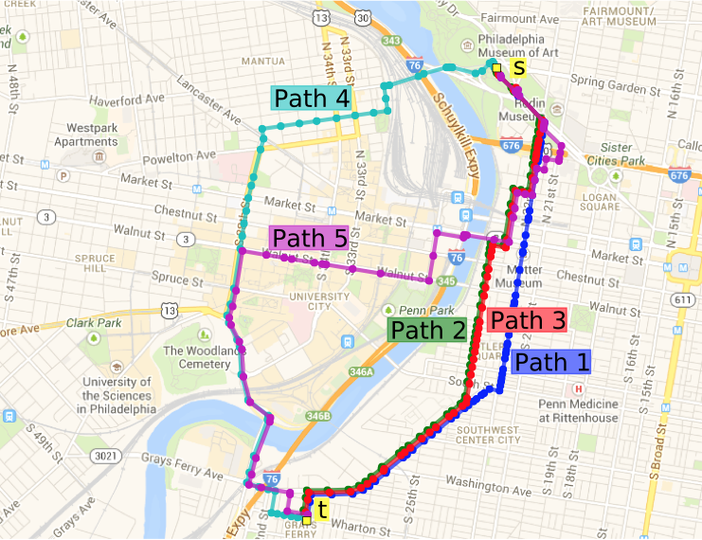
Retail Services: Ecommerce Delivery Service Routing
Goal
Enable delivery within 60 minutes to compete with Amazon Prime
Solution
With graph, we can identify the fastest delivery route requires support for complex routing queries at scale with fast and consistent performance
Challenge
Calculate best route option in real-time
Offer more predictable delivery time

Slide 32
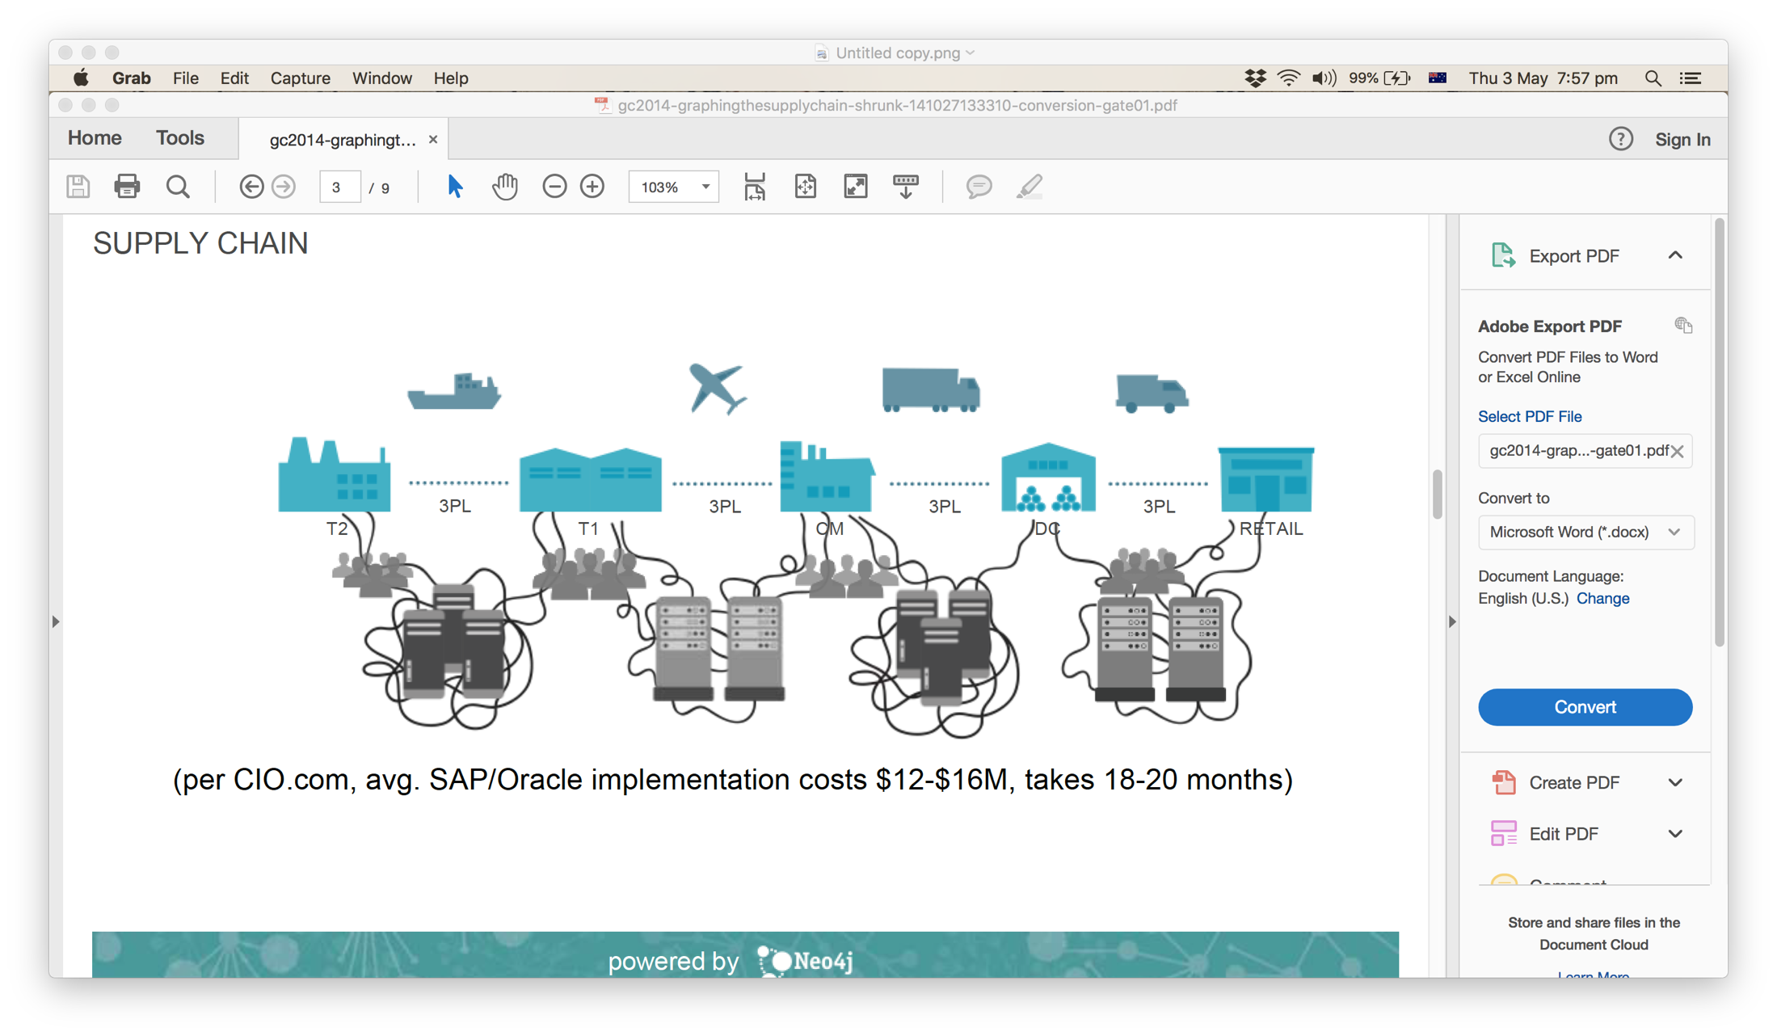
Retail Services: Supply Chain Visibility
Goal
Visualize the supply chain and easily to explore for the clients
Solution
With graph, we can easily explore the supply chain with graph traversal operations
Challenge
the volume and structure of information to be processed are huge and complex

Slide 33
Investment Analysis
A complete knowledge of an enterprise facilitate investment analysis, which requires:
Own profile: financial status, innovation strength of long credit
Ownership and investment relationships
The stronger the owner and relevant, the higher the investing potential
Linking all companies via their investment relations requires graph database

Slide 34
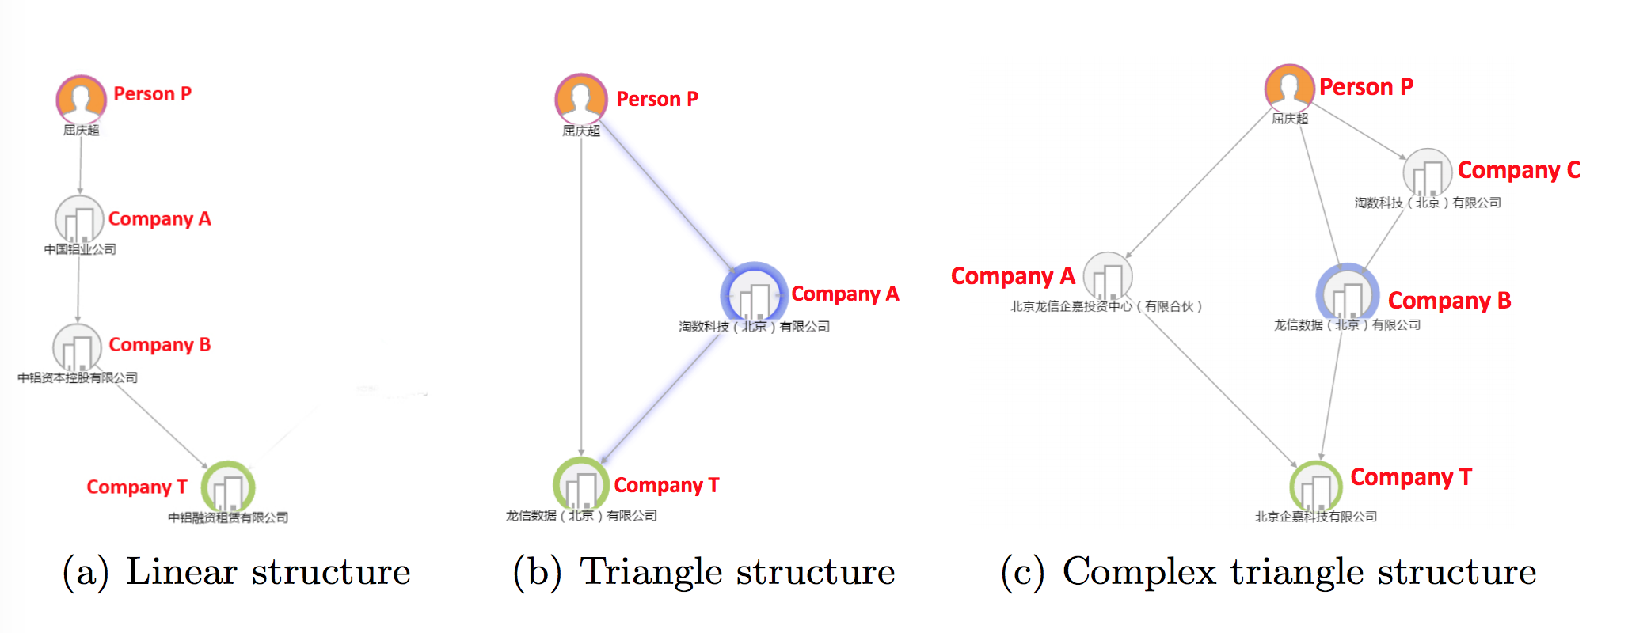
Investment Analysis
Reveal an enterprise’s real controllers: the person who owns the biggest equity share, directly or indirectly

Slide 35
Investment Analysis
Enterprise path discovery
Whether there are paths to reach new customers
the potential paths from the competitors to the new customers
Invested
…
Investing company
Invested by Blue
…
Competitors
Ooops, competitors approached first
New Customers

Slide 36
Investment Analysis
Multidimensional relationships discovery:
competitors
pattern transfer
acquisition
investment
Why this can help?
Difficulties of investing a target company? Try negotiate with the competitors’ targets.

Slide 37
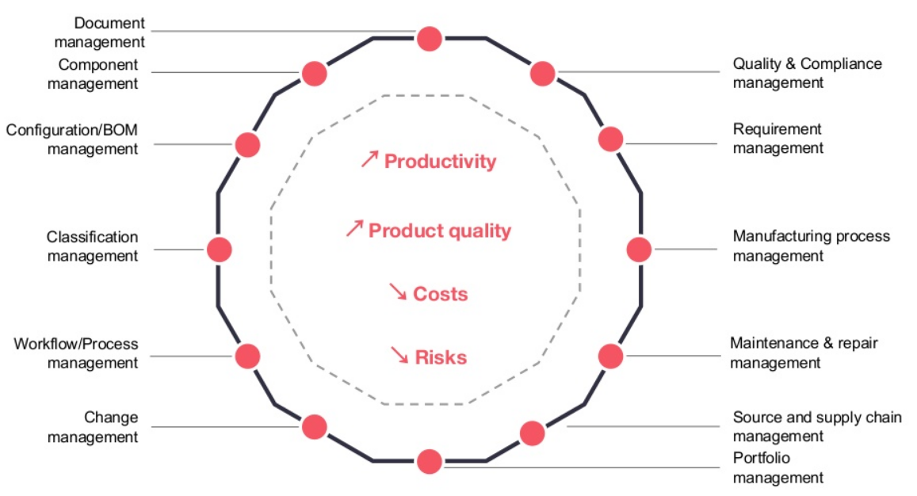
Product Lifecycle Management
Product lifecycle management is the process of managing the entire lifecycle of a product from design stage to development to go-to-market to retirement to disposal

Slide 38
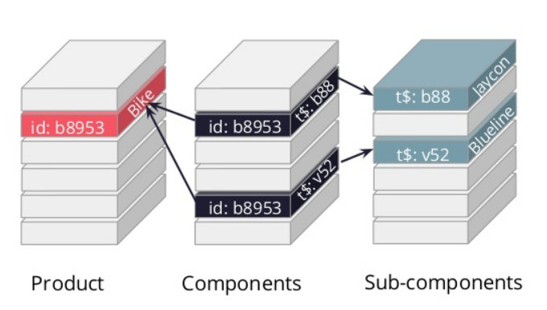
Product Lifecycle Management
Existing PLM systems rely on RDBMS
Siloed data, inability to model real-life complexities and to adapt to changes
Inability to scale data model without costs and risks as business evolves
Search for information is time-consuming
Missing insights regarding dependencies leads to poor decisions and increase risks

Slide 39
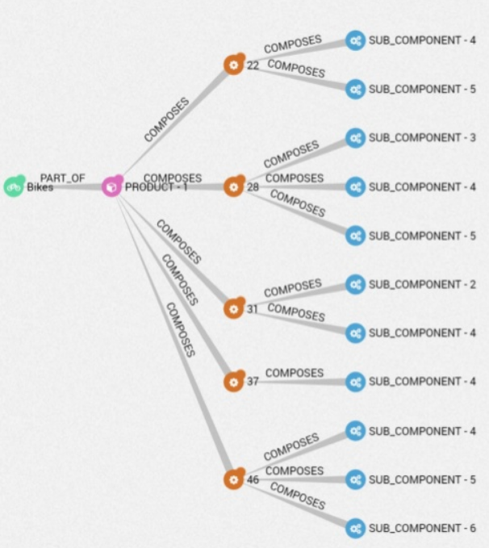
Product Lifecycle Management
Represent cross-department data about products and processes as a graph and store it as one
Aggregate product hierarchies and connections into a single source of truth
Easily edit, or expand your model as your need evolve
Saving time by searching and exploring your data
Visually track dependencies between entities and get contextual insights

Slide 40
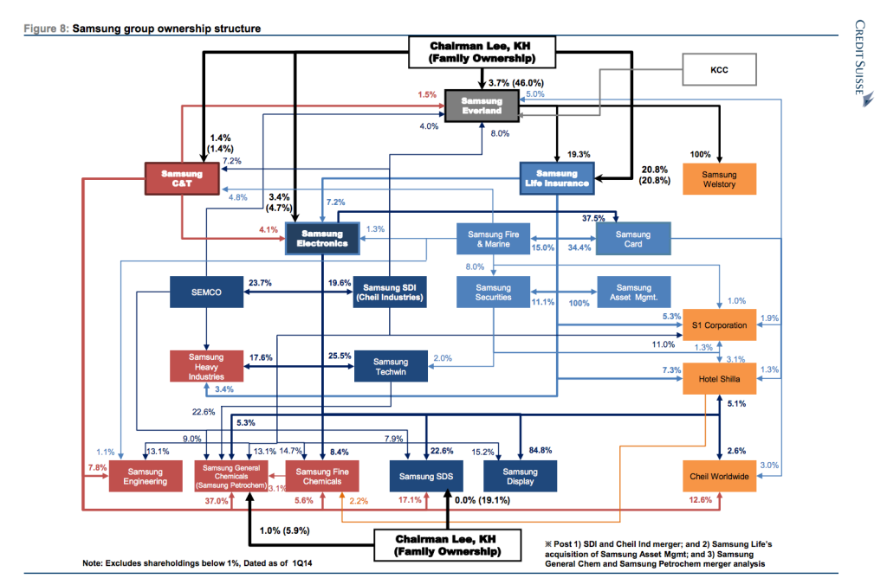
Anti Money Laundering
Samsung Group

Slide 41
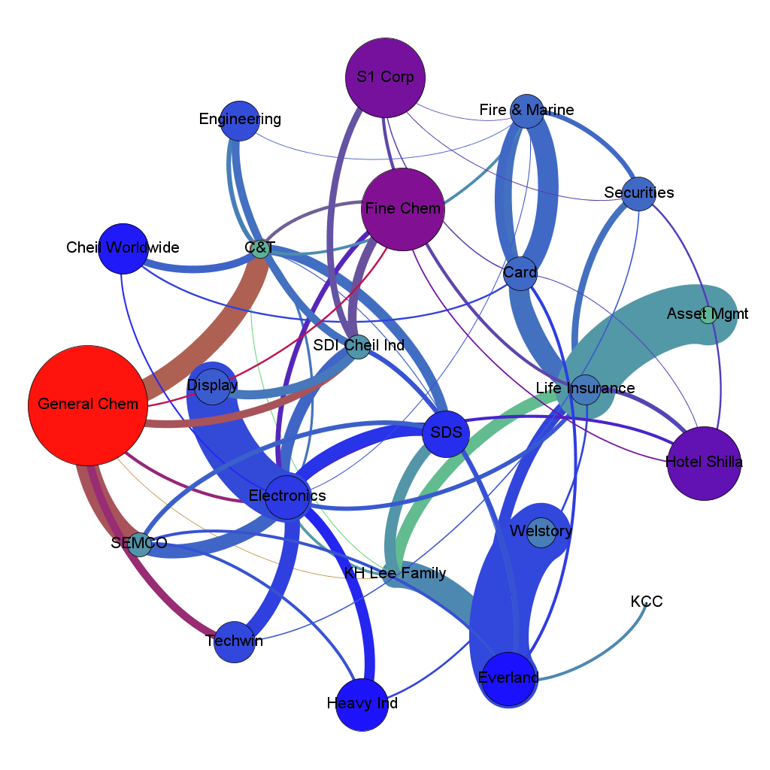
Anti Money Laundering: Graph Model
More than a pretty picture
Graph structure for deep quantitative analysis

Slide 42
Anti Money Laundering: Graph Model
Classical measures of centrality, like degree and betweeness, and eccentricity:
to correlate such measures with a propensity of fraud
Complex circular money flows:
the native graph structure can also be used to input, track and calculate transactions across these chains.
profit distributions flow from one company to another via many different paths

Slide 43
Anti Money Laundering: Some Insights
Global-scale organisation fosters complex transaction flows
can be circular, making it impossible to investigate ML using traditional method.
Graph not only can visual, but can model the data for deep analysis
Graph properties such as eccentricity and betweenness are useful factors to correlate the potential ML.
Path, cycle and pattern analysis can facilitate the AML process

Slide 44
Cybersecurity
Goal
A unified web framework to manage cyber attack relationships in the network
Understand how cyber attackers can leverage initial footholds to extend their reach through the network
Challenge
correlate data from numerous sources into a common model
flexible and easy to extend, and map naturally to network attack relationships
Support various kinds of network attack relationships queries

Slide 45
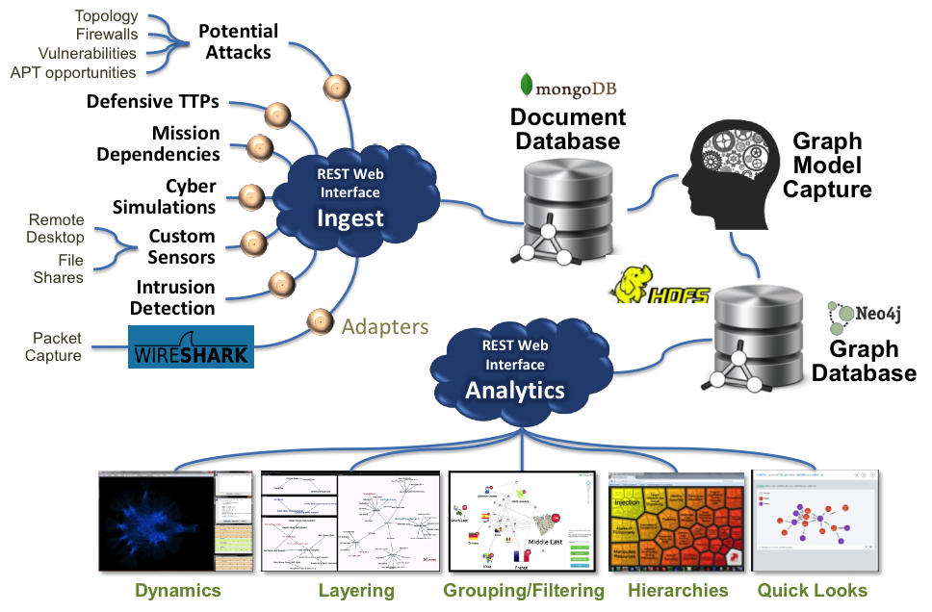
Cybersecurity: MITRE Case Study
Solution
Graph model

Slide 46
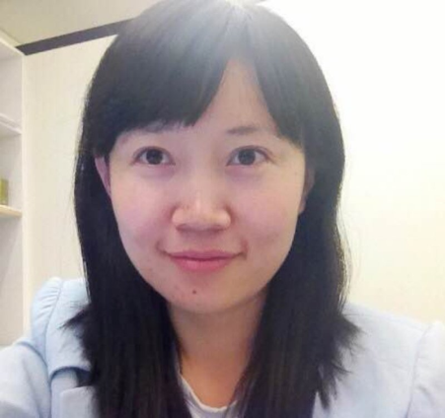
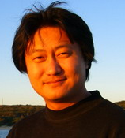
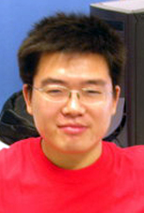
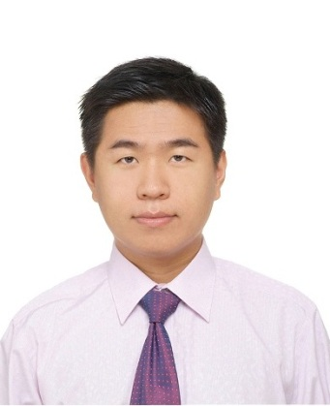
Many thanks to my team
A/Prof. Wenjie Zhang
100+ ERA A* (CCF A) ranked papers
Associate Head of CSE, UNSW
Graph Data, Spatial-Temporal Data, Algorithms
A/Prof. Ying Zhang
80+ ERA A* (CCF A) ranked papers
University of Technology Sydney (UTS)
Social Network, Streaming Data, Algorithm
Dr. Lu Qin
60+ ERA A* (CCF A) ranked papers
Senior Lecturer of UTS
Big Graph Computing, Algorithm
Dr. Xin Cao
20+ ERA A* (CCF A) ranked papers
Senior Lecturer of UNSW
Social Network, Data Mining, Algorithm
Dr. Yixiang Fang: Postdoctoral Fellow of UNSW，Social Network, Big Graph Computing.
Dr. Xing Feng: Postdoctoral Fellow r of UTS, Big Graph Computing.
Dr. Longbin Lai: Postdoctoral Fellow of UNSW, Big Graph Computing.
Dr. Long Yuan: Postdoctoral Fellow of UNSW, Big Graph Computing.
Many past students and current students
Dr Ying Zhang
CSE, UNSW

Slide 47
graph pattern matching

Slide 48
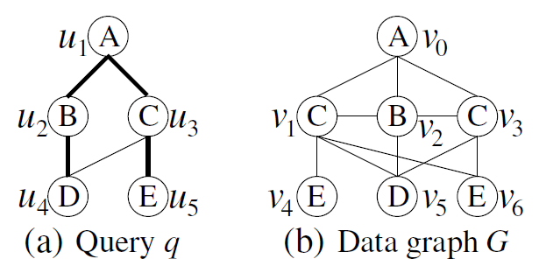
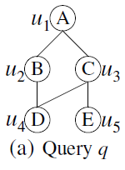
Introduction
Subgraph Matching
Given a query q and a large data graph G, the problem is
to extract all subgraph isomorphic embeddings of q in G.
Notes:
Note that the subgraph isomorphic embedding here requires one-on-one injective mapping between query nodes and data vertices.
Let’s consider the following example, in which the capital letters represent the labels of vertices.
In this example, this query q has the following three subgraph isomorphic embeddings in G.

Slide 49
Introduction
Subgraph Matching
Given a query q and a large data graph G, the problem is
to extract all subgraph isomorphic embeddings of q in G.

Slide 50
Introduction
Subgraph Matching
Given a query q and a large data graph G, the problem is
to extract all subgraph isomorphic embeddings of q in G.

Slide 51
Introduction
Subgraph Matching
Given a query q and a large data graph G, the problem is
to extract all subgraph isomorphic embeddings of q in G.

Slide 52
Graph Pattern Matching: summary
Related Applications
Fraud Detection, Anti Money Laundering, Cyber Security etc.
Algorithms and Recent Publications
Exact Match
Tree Sequence (QuickSI), VLDB’08
Core-Forest-Leaf Decomposition (CFL Algorithm), Sigmod’16
Optimal Distributed Join-based algorithms, VLDB’15, VLDB’17
Approximate Match
Spanning-tree-based matching algorithm (TreeSpan), SIGMOD’12
Supergraph Match
Tree-index-based supergraph search algorithm, DGTree, ICDE’16
Tree Match
Lawler-procedure-based top-k tree searching algorithm, VLDB’15

Slide 53
Detecting Designated Communities
Applications:
Group of Terrorists, Anomaly detection etc.
Challenges:
Subgraph Isomorphism is NP complete.
Graph data and results can be huge (MB-scale graph can produce PB-scale results).
Data Graph
Query Graph

Slide 54
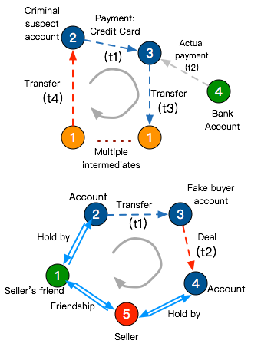
Alibaba Big Graph Computing- RT Cycle Detection
Applications：
Fraud detection
Money laundering detection
Challenges:
Large-scale dynamic graph (100-million-scale vertices, billion-scale edges）
High demand on real-time processing: 10-50ms response time, while previous system takes 50s
Solutions:
Real-time cycle detection on each edge
Light-weighted index structure (easy to maintain and update) and efficient query algorithm
Real-data simulation：
Detect 6-edge cycles within 10ms

Slide 55
Single CPU

Slide 56
QuickSI (VLDB2008)
Synchronized Depth-First Traversal
3
4
1
2
5
7
6
q
Forwarding
1
2
3
4
5
Backtracking
7
6
g₁
g₂
g₃
Determine the access order in q
Detect corresponding subgraphs in g₁, g₂ which can be mapped to the currently traversed vertices.

Slide 57
TurboISO (SIGMOD2013)
Overview of TurboISO
Neighborhood Equivalence Class (NEC)
Merging vertices with same neighbor to reduce query size
Combine / Permute strategy
Candidate Region Exploration
Constructed on-the-fly based on q
A path-based data structure containing all embeddings of q in G

Slide 58
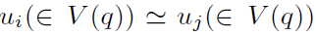
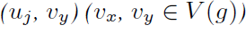
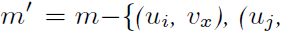
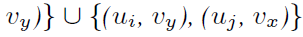
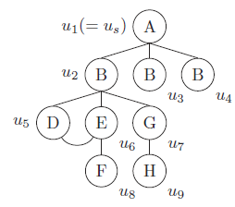
Neighborhood Equivalence Class(NEC)
Definition
Let be an equivalence relation over all query vertices in q such that, if for every embedding m that contains and , there exists an embedding m’ such that
Example
u₃ and u₄ are NEC nodes .

Slide 59
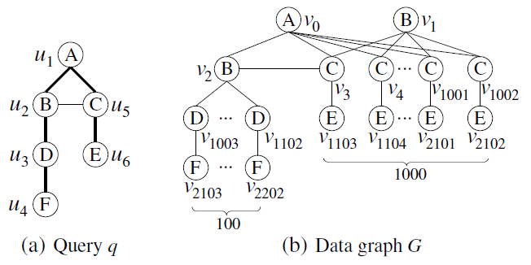
CFL-Match (SIGMOD2016)
Reduce Candidates
10⁵ - 100 partial mappings are redundant.
Matching order of QuickSI and Turbo_{ISO} : (u₁，u₂，u₃，u₄，u₅，u₆).
(u₁，u₂，u₅，u₃，u₄，u₆)
Cartesian products:
100 mappings (v₀，v₂， v_{1000+i}， v_{2100 +i}) (3 ≤ i ≤ 102) of (u₁，u₂，u₃，u₄)
1000 mappings (v₀, v_{j}) (3 ≤ j ≤ 1002) of (u₁，u₅)

Slide 60
Compression
Originally proposed by Qiao et al. [7]
Intuition
Subgraph enumeration can generate enormous (intermediate) results
Some vertices can be compressed as they are not needed in future computation
Heuristics by [7]: the vertices that do not belong to the minimum vertex cover (MVC)
v0
v3
v1
v2
Vertices in MVC
Vertices to compress

Slide 61
Distributed Subgraph Enumeration
(VLDB2015 & VLDB2017)

Slide 62
Single CPU

Slide 63
QuickSI (VLDB2008)
Synchronized Depth-First Traversal
3
4
1
2
5
7
6
q
Forwarding
1
2
3
4
5
Backtracking
7
6
g₁
g₂
g₃
Determine the access order in q
Detect corresponding subgraphs in g₁, g₂ which can be mapped to the currently traversed vertices.

Slide 64
TurboISO (SIGMOD2013)
Overview of TurboISO
Neighborhood Equivalence Class (NEC)
Merging vertices with same neighbor to reduce query size
Combine / Permute strategy
Candidate Region Exploration
Constructed on-the-fly based on q
A path-based data structure containing all embeddings of q in G

Slide 65
Neighborhood Equivalence Class(NEC)
Definition
Let be an equivalence relation over all query vertices in q such that, if for every embedding m that contains and , there exists an embedding m’ such that
Example
u₃ and u₄ are NEC nodes .

Slide 66
CFL-Match (SIGMOD2016)
Reduce Candidates
10⁵ - 100 partial mappings are redundant.
Matching order of QuickSI and Turbo_{ISO} : (u₁，u₂，u₃，u₄，u₅，u₆).
(u₁，u₂，u₅，u₃，u₄，u₆)
Cartesian products:
100 mappings (v₀，v₂， v_{1000+i}， v_{2100 +i}) (3 ≤ i ≤ 102) of (u₁，u₂，u₃，u₄)
1000 mappings (v₀, v_{j}) (3 ≤ j ≤ 1002) of (u₁，u₅)

Slide 67
Compression
Originally proposed by Qiao et al. [7]
Intuition
Subgraph enumeration can generate enormous (intermediate) results
Some vertices can be compressed as they are not needed in future computation
Heuristics by [7]: the vertices that do not belong to the minimum vertex cover (MVC)
v0
v3
v1
v2
Vertices in MVC
Vertices to compress

Slide 68
Distributed Techniques

Slide 69
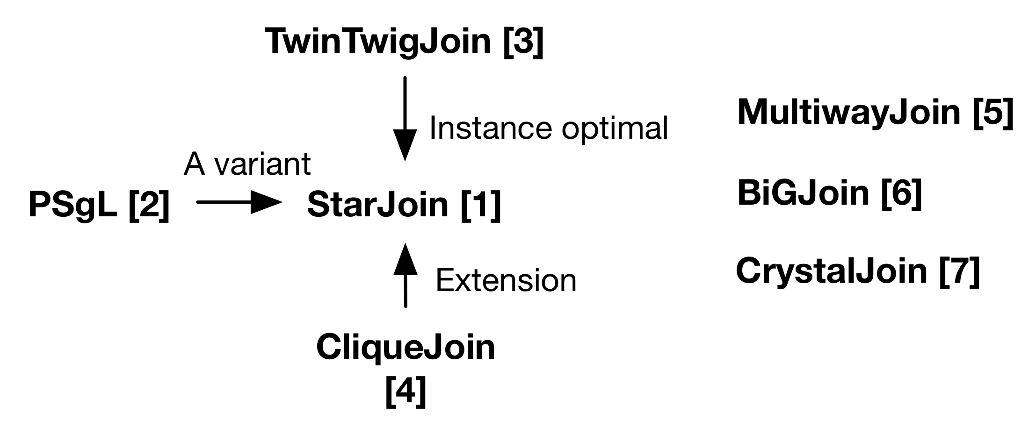
A Thriving Literature

Slide 70

Categorizing by Strategies

Slide 71

Related Works
PSgL [Shao et al., Sigmod 2014]
BFS Search strategy, Vertex-centric computation
Analogous to decomposing into stars and then processing Star-based join.
Several issues including memory issues

Slide 72

BinaryJoin Strategy
Divide the pattern graph into a set of join units { p1, p2, …, pk }
Process k-1 join following specific join order
We prove that CliqueJoin is worst-case optimal by showing that it can be expressed as GenericJoin proposed by Ngo et al. [8]

Slide 73


StarJoin Algorithm
Round 4
Round 3
Round 2
Round 1
StarJoin

Slide 74


Trade-off for stars as join units
# of matches to a star is massive if many edges in a star.
A node with 1,000,000 neighbors => ${10}^{18}$ matches of a 3-star
Not unusual: a node contains many neighbors in a large social networks or web graphs
If star with many edges, a join followed has more pruning power; i.e., less # intermediate results of a join.

Slide 75



















Star-based Join
Star decomposition
Left-deep Join
$$v_{1}$$
$$v_{4}$$
$$P$$
$$v_{2}$$
$$v_{3}$$
$$v_{4}$$
$$v_{4}$$
$$v_{4}$$
$$v_{1}$$
$$v_{2}$$
$$v_{3}$$
$$v_{2}$$
$$v_{3}$$
$$v_{3}$$
$$p_{0}$$
$$p_{1}$$
$$p_{2}$$

Slide 76

Star-based Join Tradeoff

Slide 77

TwinTwigJoin Algorithm
Round 4
Round 3
Round 2
Round 1
StarJoin
TwinTwigJoin

Slide 78
TwinTwig Join VLDB15’
TwinTwig: A star of at most two edges

Slide 79
TwinTwig Join VLDB15’
Given any star-based join, star, there always exists a
TwinTwig join, tt, s.t. the size of intermediate results of tt is no larger than that of star.

Slide 80

CliqueJoin Algorithm
Round 4
Round 3
Round 2
Round 1
StarJoin
TwinTwigJoin
CliqueJoin

Slide 81




The drawbacks of TwinTwig Join
Simple graph storage only supports using star (TwinTwig) as join units, which can result in too many intermediate results
(e.g. a node of degree 1,000,000, O(10^18) stars, O(10^12) TwinTwigs)
Left-deep join can result in sub-optimal solution

Slide 82



General Algorithmic Framework
Graph Storage
Stored as (u; G_{u}) for each data node u
G_{u} is called the local graph of u such that:
(1) it is connected;
(2) ;
(3)

Slide 83


General Algorithmic Framework
The structure into which we decompose the pattern graph are called the join unit
e.g. Star in Star-based join, TwinTwig in TwinTwig Join
A structure p can be the join unit iff.
where stands for the matches of p in

Slide 84

General Algorithmic Framework
Decomposing
Left-deep tree
Bushy tree

Slide 85
SEED VLDB2017
SCP (Star-Clique-Preserved) graph storage: Use star and clique as the join units
We can avoid using star if clique is an alternative
Shorter execution. The 6-clique can now be processed in one single round, instead of 7 rounds in TwinTwig Join
Bushy join plan: Optimality Guarantee
The search space of an optimal bushy join covers that of a left-deep join

Slide 86



SCP Graph Storage
SCP Graph, each local graph is denoted as
We include the edges among the neighbors into the local graph Gu, so that all cliques with u can be fully computed within

Slide 87


Optimal Bushy Join
Notations
: the join plan to solve P
: the cost of the join plan
: estimated # matches of P in G (We apply
powe-law random graph model for the estimation,
while estimation can vary with applications)
We aim at finding a join plan for P , s.t
is minimized

Slide 88


Optimal Bushy Join
A dynamic programming transform function:

Slide 89
References
Z. Sun, H. Wang, H. Wang, B. Shao, and J. Li. Efficient subgraph matching on billion node graphs. PVLDB, 5(9), 2012.
Y. Shao, B. Cui, L. Chen, L. Ma, J. Yao, and N. Xu. Parallel subgraph listing in a large-scale graph. In SIGMOD'14, pages 625-636.
L. Lai, L. Qin, X. Lin, and L. Chang. Scalable subgraph enumeration in mapreduce. PVLDB, 8(10), 2015.
L. Lai, L. Qin, X. Lin, Y. Zhang, L. Chang, and S. Yang. Scalable distributed subgraph enumeration. PVLDB, 10(3), 2016.
F. N. Afrati, D. Fotakis, and J. D. Ullman. Enumerating subgraph instances using map-reduce. In Proc. of ICDE, 2013.
K. Ammar, F. McSherry, S. Salihoglu, and M. Joglekar. Distributed evaluation of subgraph queries using worst-case optimal low-memory dataflows. PVLDB, 11(6), 2018.
M. Qiao, H. Zhang, and H. Cheng. Subgraph matching: On compression and computation. PVLDB, 11(2), 2017.
H. Q. Ngo, E. Porat, C. Re, and A. Rudra. Worst-case optimal join algorithms. J. ACM, 65(3), 2018.
H. Kim, J. Lee, S. S. Bhowmick, W.-S. Han, J. Lee, S. Ko, and M. H. Jarrah. Dualsim: Parallel subgraph enumeration in a massive graph on a single machine. SIGMOD '16, pages 1231{1245, 2016.

Slide 90
Optimal Enumeration: Efficient Top-k Tree Matching (VLDB2015)

Slide 91
Introduction
Data Graph: a node-labeled directed graph G
Query: a node-labeled rooted tree T
Find k mappings from T to G with the minimum lengths.
u₁
C
v₁
C
v₂
C
Query Tree T:
Data Graph G:
u₂
S
u₃
E
v₃
S
v₄
E
S
v₅
Top-1 Match
Length=2
v₁
C
Top-2 Match
Length=2
v₂
C
Top-3 Match
Length=3
v₁
C
v₃
S
v₄
E
v₅
S
v₄
E
v₅
S
v₄
E

Slide 92
Applications of Top-k Tree Matching
Top-k tree matching strengthen the relevance of twig-pattern matching results
Twig-pattern matching is a core operation in XQuery over XML/Graph data
Exponential number of matches
It is also used as a key building block to retrieve top-k graph pattern matches

Slide 93
State-of-the-art Approach[Gou’08]
Time Complexity of the existing techniques
O(n_{T}(d_{T} + log k)) for enumerating each top-i match
n_{T}: number of nodes in T
d_{T}: the maximum node degree in T
Our contribution in this paper: we propose a new enumeration paradigm to enumerate each match in O(n_{T} + log k) time

Slide 94
Ａ New Enumeration Strategy
The solution space: all valid matches in V₁ × V₂ × … × V_{n}
{u₁,u₂,…,u_{n}}: the set of nodes T
V_{i}: the set of nodes in G having the same label as u_{i.}
Adapt Lawler’s Procedure to compute top-k matches
Suppose (v₁,v₂,…,v_{n}) is the top-1 match, then the entire solution space is divided into n subspaces
(V₁ − {v₁}) × V₂ × … × V_{n}
{v₁} × (V₂ − {v₂}) × … × V_{n}
…
{v₁} × {v₂} × … × (V_{n} − {v_{n}})
Top-2 match is the match with lowest score among best matches in these obtained subspaces.
How to efficiently compute the best match in a subspace?

Slide 95
Two Types of Subspaces
Categorize the n subspaces into two types
Let {v₁} × {v₂} × … x (V_{i} – U_{i}) × … × V_{n} be divided by (v₁,v₂,…,v_{n})
Type-1: {v₁} × {v₂} × … × (V_{i} – U_{i} - v_{i}) × … × V_{n}
Only one such type of subspace
Type-2: {v₁} × {v₂} × … × {v_{i}} × … × (V_{j} – v_{j}) × … × V_{n}
(n – i) such type of subspaces
For efficient computation, order the nodes
in T in a top-down fashion (e.g., u₁, u₂, u₃, u₄).
u₁
u₂
u₃
u₄

Slide 96
An Optimal Approach
Compute the score of the best match in a subspace
One Type-1 subspace: takes time O(log k)
(<n) Type-2 subspaces: each takes time O(1)
The matching details if needed can be obtained in O(n) time.
Each top-i match can be computed in O(n + log k) time
This is optimal, since log k usually is much smaller than n

Slide 97
Exact Subgraph Match
Applications:
Protein Interactions, Graph Classification, Chemical Compound search, Anomaly detection etc.
Challenges:
Subgraph Isomorphism is NP complete.
Graph data and results can be huge (MB-scale graph can produce PB-scale results).
Algorithms and publications:
Tree Sequence (QuickSI), VLDB’08
Core-Forest-Leaf Decomposition (CFL Algorithm), Sigmod’16 (enumeration)
Optimal Join-based algorithms, VLDB’15, VLDB’17
Contributions
CFL is 100 times faster than the state-of-the-art，thousands of times faster than Neo4j
Distributed join-based algorithm has high scalability, can process billion-scale graphs in a small cluster (10 computing nodes).
Data Graph
Query Graph
Problem Definition:
Given a query graph and data graph, find all subgraphs in the data graph that match the query graph.
Data graph can be a large graph, or a set of medium-sized graphs.
The vertices (edges) may or may not be labelled.

Slide 98
Approximate Subgraph Match
Applications:
Exact matching is too constrained, in addition, the data graph may be incomplete, and it may be unclear to users whether a query is exactly what they want.
Challenges:
Harder than exact match (equal to processing multiple exact matches).
The solution set can be huge.
Algorithms and publications
Spanning-tree-based matching algorithm (TreeSpan), SIGMOD’12
Contributions:
Minimum-cost spanning tree index
Targeting maximum match to reduce the size of solution set
4 orders of magnitude faster than the state-of-the-art
A
B
A
A
B
C
D
E
C
D
Query Graph
（Allow one edge mis-matched）
Data Graph
There is no exact match in the above example.
However, if it is allowed to mis-match one edge,
we can find the red-marked match
(miss (B, D) edge).
Problem Definition:
Regarding exact matching, here we allow at most a certain number of mis-matched edges.

Slide 99
Supergraph Match
Applications:
Protein-protein interaction analysis, Chemical compound search
Challenges:
Complexities: Subgraph isomorphism, NP complete
Data scale：up to the scale of hundreds of vertices, compared to tens in the state-of-the-art
Algorithms and publications:
Tree-index-based supergraph search algorithm, DGTree，ICDE’16
Contributions:
Propose the index called DGTree that is free from the costly subgraph mining procedure.
Based on DGTree, propose the algorithm that is free from verification
8 times faster than the state-of-the-art
Query
Graph
Data
Graph
Problem Definition:
Given a query graph and a graph database, search all graphs in the database that are contained by the query graph.
Can be seen as the transposed query of subgraph pattern matching.

Slide 100
Cohesive subgraphs

Slide 101

Applications
Fraud detection
“Customer”
Products
Notes:
Web spam, link
Same pholosiphy

Slide 102
Cohesive Subgraph Models
Global cohesiveness: cliques and variants
Node and edge constraints: k-core, k-truss, k-fortress
Connectivity: k-ECC, k-VCC

Slide 103

Cliques
Every pair of vertices pair is connected
A clique is called maximal clique if there exist no other bigger cliques that contain it
Also called complete graph
R. D. Luce and A. D. Perry, “A method of matrix analysis of group structure,” Psychometrika, vol. 14, no. 2, pp. 95–116, 1949
Notes:
Familiarity, reachability, robustness

Slide 104



Variations of cliques: quasi-clique
Quasi-clique: relax on density or degree.
total # of edges: $\frac{|V|(\left|V\right|−1)}{2}$ to
$γ$ $\frac{|V|(\left|V\right|−1)}{2}$
$γ=0.8$
H. Matsuda, T. Ishihara, A. Hashimoto. Classifying molecular sequences using a linkage graph with their pairwise similarities. Theor. Comput. Sci., 1999
Notes:
Quasi c

Slide 105

Variations of cliques: k-plex
K-plex: relax vertex degree from n-1 to n-k, n is number of vertices in the subgraph
S. Seidman and B. Foster. “A graph-theoretic generalization of the clique concept. Journal of Mathematical Sociology”, 139-154, 1978.
Notes:
Relax of familiarity

Slide 106

Variations of cliques: k-clique and k-club
k-clique: the subgraph such that the distance between any two vertices in original graph is within k
k-club: a subgroup with diameter within k
Clique: (1, 2, 3)
2-clique: (1,2,3,4,5),(2,3,4,5,6,)
2-club: (1,2,3,4),(1,2,3,5),(2,3,4,5,6)
R.D. Luce. Connectivity and generalized cliques in sociometric group strucuture. Psychometrika, 15(2): 169-190, 1950.
R.J. Mokken. Clique, clubs and clans. Quality and Quantity, 13(2): 161-173, 1979.
Notes:
The definition of all above models involves mutual connectivity or degree requirement of vertices within the same set, and the computation of retrieving all maximal subgraphs or he maximum subgraph is NP-hard.
Relax the reachability from 1 to k

Slide 107
K-core
Given a graph G, the k-core of G is a maximal subgraph where each vertex has at least k neighbors.
S. B. Seidman. Network structure and minimum degree. Social networks, 5(3):269–287, 1983.
v₄
v₇
v₆
2-core
3-core
v₂
v₃
v₅
v₁
v₈
Notes:
Polynomial time to compute

Slide 108

K- truss
A maximal subgraph where each edge has a support of at least k-2. Edge support is the number of triangles which contains the edge.
M. Granovetter. The strength of weak ties. American Journal of Sociology, 1360-1380, 1973.
M. Wang, C. Wang, J. X. Yu, and J. Zhang, Community detection in social networks: An in-depth benchmarking study with a procedure-oriented framework. PVLDB, 8(10):998–1009, 2015.
Notes:
Intuition: if neighbors u and v have a common neighbor w, w “endorse” the connection of u and v. —> triangle {u,v,w}. More triangles, more endorsement

Slide 109


p-cohesion
A subgraph S where the degree of each vertex u in S is at least p fraction of the whole graph. deg(u, S) $≥p$ deg(u, G)
S. Morris, Contagion. The Review of Economic Studies 67(1): 57-78, 2000.
C. Li, F. Zhang, Y. Zhang, L. Qin, W. Zhang, X. Lin, Discovering Fortress-like Cohesive Subgraphs, under review.

Slide 110
K-edge connected components
Given a graph G, a subgraph is k-edge connected if it is still connected after removing any set of (k-1) edges from it
8
11
1
2
6
7
9
10
4
2-edge connected components
3
5
J., Camille . "Sur les assemblages de lignes". Journal für die reine und angewandte Mathematik (in French). 70 (2): 185–190, 1869.
Notes:
Change to a different figure

Slide 111

K-vertex connected components
Given a graph G, a subgraph is k-vertex connected if it is still connected after removing any set of (k-1) vertices from it
2-vertex connected components
S. Even and R. E. Tarjan. Network flow and testing graph connectivity. SIAM J. Comput., 4, 1975.
Notes:
Also called structural cohesion

Slide 112
Hierarchical decomposition
Compute cohesive subgraphs w.r.t all possible parameters, e.g., k-core for all possible k values

Slide 113

Hierarchical decomposition
C. Giatsidis et al, Journal of Machine Learning Research, 2016.

Slide 114
Different Cohesive Models
Level of cohesiveness
Computational cost
Different applications
Notes:
Clique: most cohesive most expensive to compute. K-core: linear time computation, least cohesive.
Clique: biological. K-core, k-truss, p-cohesion: powerful in social network analysis. k-ECC k-VCC: connectivity, robustness

Slide 115
Butterfly Counting for Large-scale Bipartite Networks

Slide 116


Introduction
Bipartite network:
(Adam)
(Mark)
(Shego)
(Taylor)
(Balm)
(Doll)
(Hat)
(Wine)
(Carpet)

Slide 117
Introduction
The smallest non-trivial biclique: butterfly
(Adam)
(Mark)
(Shego)
(Taylor)
(Balm)
(Doll)
(Hat)
(Wine)
(Carpet)
Notes:
Since network motifs (i.e., repeated sub-graphs) are regarded
as basic building blocks of complex networks,
nding and counting motifs of networks is a key to network
analysis.

Slide 118




Introduction
Butterfly counting: compute the number of butteries in a bipartite graph G, denoted by
$$⋈$$
$$G$$
(Adam)
(Mark)
(Shego)
(Taylor)
$$⋈$$
= 4
$$G$$
(Balm)
(Doll)
(Hat)
(Wine)
(Carpet)
G

Slide 119
Introduction
Butterfly counting: compute the number of butteries in a bipartite graph G, denoted by
$$⋈$$
$$G$$
(Adam)
(Mark)
(Shego)
(Taylor)
(Balm)
(Doll)
(Hat)
(Wine)
(Carpet)
G

Slide 120
Introduction
Butterfly counting: compute the number of butteries in a bipartite graph G, denoted by
$$⋈$$
$$G$$
(Adam)
(Mark)
(Shego)
(Taylor)
(Balm)
(Doll)
(Hat)
(Wine)
(Carpet)
G

Slide 121
Introduction
Butterfly counting: compute the number of butteries in a bipartite graph G, denoted by
$$⋈$$
$$G$$
(Adam)
(Mark)
(Shego)
(Taylor)
(Balm)
(Doll)
(Hat)
(Wine)
(Carpet)
G

Slide 122
Introduction
Butterfly counting: compute the number of butteries in a bipartite graph G, denoted by
$$⋈$$
$$G$$
(Adam)
(Mark)
(Shego)
(Taylor)
(Balm)
(Doll)
(Hat)
(Wine)
(Carpet)
G

Slide 123




Applications
Bipartite clustering coefficient (c) –
Network measurement: high bipartite clustering coefficient indicates localized closeness; a building block for creating community structure [Aksoy et. al, 2017].
K-wing – each edge in k-wing has at least k number of butterflies [Sarıyüce et. al, 2018].
Community detection; word-document clustering; viral marketing ...
$$⋈$$
$$c= \frac{4 }{}$$
$$G$$
- the number of three-paths (computed in O(m))

Slide 124
Related Works
Unipartite networks
- triangle counting: [1], [2], [3], [4], …
- other motifs: 4-vertices [5], 5-vertices [6], cycles of length k [7], …
Bipartite networks
- butterfly counting: BFC-BS [8], BFC-IBS [9], …
- other motifs: 3x3 biclique [10], 4-path [11], …
State-of-the-art
[1] M. Al Hasan and V. S. Dave. Triangle counting in large networks: a review. Wiley Interdisciplinary Reviews: Data Mining and Knowledge Discovery, 2018.
[2] L. Becchetti, P. Boldi, C. Castillo, and A. Gionis. Efficient semi-streaming algorithms for local triangle counting in massive graphs. In KDD,2008.
[3] L. Chang, C. Zhang, X. Lin, and L. Qin. Scalable top-k structural diversity search. In ICDE, 2017.
[4] X. Hu, Y. Tao, and C.-W. Chung. Massive graph triangulation. In SIGMOD, 2013. [5] M. Jha, C. Seshadhri, and A. Pinar. Path sampling: A fast and provable method for estimating 4-vertex subgraph counts. In WWW, 2015. [6] A. Pinar, C. Seshadhri, and V. Vishal. Escape: Efficiently counting all 5-vertex subgraphs. In WWW, 2017.
[7] N. Alon, R. Yuster, and U. Zwick. Finding and counting given length cycles. Algorithmica,1997.
[8] J. Wang, A. W.-C. Fu, and J. Cheng. Rectangle counting in large bipartite graphs. In BigData Congress, 2014.
[9] S.-V. Sanei-Mehri, A. E. Sariyuce, and S. Tirthapura. Butterfly counting in bipartite networks. In KDD, 2018.
[10] S. P. Borgatti and M. G. Everett. Network analysis of 2-mode data. Social networks, 1997.
[11] T. Opsahl. Triadic closure in two-mode networks: Redefining the global and local clustering coefficients. Social Networks, 2013.

Slide 125

State-of-the-art
BFC-BS & BFC-IBS
u0
u1
u2
u3
(Adam)
(Mark)
(Shego)
(Taylor)
BFC-IBS improves BFC-BS in two aspects: (1) pre choosing the layer of start-vertices to achieve a lower time complexity; (2) using a hash map to speed up the implementation.
(3) avoid counting a butterfly twice (process the wedge (u, v, w) only if w.id > u.id)
v0
v1
v2
v3
v4
(Balm)
(Doll)
(Hat)
(Wine)
(Carpet)

Slide 126
State-of-the-art
BFC-BS & BFC-IBS
u0
u1
u2
u3
(Adam)
(Mark)
(Shego)
(Taylor)
BFC-IBS improves BFC-BS in two aspects: (1) pre choosing the layer of start-vertices to achieve a lower time complexity; (2) using a hash map to speed up the implementation.
(3) avoid counting a butterfly twice (process the wedge (u, v, w) only if w.id > u.id)
v0
v1
v2
v3
v4
(Balm)
(Doll)
(Hat)
(Wine)
(Carpet)
c(v0,v1)= 1

Slide 127
State-of-the-art
BFC-BS & BFC-IBS
u0
u1
u2
u3
(Adam)
(Mark)
(Shego)
(Taylor)
BFC-IBS improves BFC-BS in two aspects: (1) pre choosing the layer of start-vertices to achieve a lower time complexity; (2) using a hash map to speed up the implementation.
(3) avoid counting a butterfly twice (process the wedge (u, v, w) only if w.id > u.id)
v0
v1
v2
v3
v4
(Balm)
(Doll)
(Hat)
(Wine)
(Carpet)
c(v0,v1)= 2

Slide 128
State-of-the-art
BFC-BS & BFC-IBS
u0
u1
u2
u3
(Adam)
(Mark)
(Shego)
(Taylor)
BFC-IBS improves BFC-BS in two aspects: (1) pre choosing the layer of start-vertices to achieve a lower time complexity; (2) using a hash map to speed up the implementation.
(3) avoid counting a butterfly twice (process the wedge (u, v, w) only if w.id > u.id)
v0
v1
v2
v3
v4
(Balm)
(Doll)
(Hat)
(Wine)
(Carpet)
c(v0,v1)= 3

Slide 129
State-of-the-art
BFC-BS & BFC-IBS
u0
u1
u2
u3
(Adam)
(Mark)
(Shego)
(Taylor)
BFC-IBS improves BFC-BS in two aspects: (1) pre choosing the layer of start-vertices to achieve a lower time complexity; (2) using a hash map to speed up the implementation.
(3) avoid counting a butterfly twice (process the wedge (u, v, w) only if w.id > u.id)
v0
v1
v2
v3
v4
(Balm)
(Doll)
(Hat)
(Wine)
(Carpet)
c(v0,v1)= 3
c(v0,v2)= 1

Slide 130


State-of-the-art
BFC-BS & BFC-IBS
u0
u1
u2
u3
(Adam)
(Mark)
(Shego)
(Taylor)
BFC-IBS improves BFC-BS in two aspects: (1) pre choosing the layer of start-vertices to achieve a lower time complexity; (2) using a hash map to speed up the implementation.
(3) avoid counting a butterfly twice (process the wedge (u, v, w) only if w.id > u.id)
v0
v1
v2
v3
v4
(Balm)
(Doll)
(Hat)
(Wine)
(Carpet)
c(v0,v1)= 3
c(v0,v2)= 1
c(v0,v3)= 1
$$⋈$$
= 3 + 0 + 0 = 3
$$\text{v}\text{0}$$

Slide 131




State-of-the-art
BFC-BS & BFC-IBS
u0
u1
u2
u3
(Adam)
(Mark)
(Shego)
(Taylor)
BFC-IBS improves BFC-BS in two aspects: (1) pre choosing the layer of start-vertices to achieve a lower time complexity; (2) using a hash map to speed up the implementation.
(3) avoid counting a butterfly twice (process the wedge (u, v, w) only if w.id > u.id)
v0
v1
v2
v3
v4
(Balm)
(Doll)
(Hat)
(Wine)
(Carpet)
$$⋈$$
= 3
$$⋈$$
= 0
$$\text{v}\text{0}$$
$$\text{v}\text{1}$$

Slide 132









State-of-the-art
BFC-BS & BFC-IBS
u0
u1
u2
u3
(Adam)
(Mark)
(Shego)
(Taylor)
BFC-IBS improves BFC-BS in two aspects: (1) pre choosing the layer of start-vertices to achieve a lower time complexity; (2) using a hash map to speed up the implementation.
(3) avoid counting a butterfly twice (process the wedge (u, v, w) only if w.id > u.id)
v0
v1
v2
v3
v4
(Balm)
(Doll)
(Hat)
(Wine)
(Carpet)
Time Complexity
O($\text{min}\text{\{}\sum_{\text{u}\text{∈}\text{U}\text{(}\text{G}\text{)}}{\text{degG}\text{(}\text{u}\text{)}\text{2}\text{,}\sum_{\text{v}\text{∈}\text{L}\text{(}\text{G}\text{)}}{\text{degG}\text{(}\text{v}\text{)}\text{2}\text{\}}}}$)
c(v2,v3)= 2
c(v2,v4)= 1
$$⋈$$
= 4
$$⋈$$
$$⋈$$
$$⋈$$
= 1
$$⋈$$
$$⋈$$
$$G$$
= 3
= 0
= 0
= 0
$$\text{v}\text{0}$$
$$\text{v}\text{1}$$
$$\text{v}\text{2}$$
$$\text{v}\text{3}$$
$$\text{v}\text{3}$$

Slide 133
State-of-the-art
Issues in handling hub vertices:
u0
u1
u2
u1000
u1001
L(G)
R(G)
v0
v1
v999
v1000
v1001

Slide 134
State-of-the-art
Issues in handling hub vertices:
The existing algorithms need to go through u₀ (or v₁₀₀₀) as the middle-vertex if choosing L(G) (or U(G)) to start.
Regardless of whether the upper or the lower layer is selected to start, we must traverse totally C2, 1000 (= 499,500) plus 1,000 different wedges by the existing algorithms.
u0
u1
u2
u1000
u1001
L(G)
R(G)
v0
v1
v999
v1000
v1001

Slide 135
State-of-the-art
Issues in handling hub vertices:
The existing algorithms need to go through u₀ (or v₁₀₀₀) as the middle-vertex if choosing L(G) (or U(G)) to start.
Regardless of whether the upper or the lower layer is selected to start, we must traverse totally C2, 1000 (= 499,500) plus 1,000 different wedges by the existing algorithms.
u0
u1
u2
u1000
u1001
L(G)
R(G)
v0
v1
v999
v1000
v1001

Slide 136
State-of-the-art
Issues in handling hub vertices:
The existing algorithms need to go through u₀ (or v₁₀₀₀) as the middle-vertex if choosing L(G) (or U(G)) to start.
Regardless of whether the upper or the lower layer is selected to start, we must traverse totally C2, 1000 (= 499,500) plus 1,000 different wedges by the existing algorithms.
u0
u1
u2
u1000
u1001
L(G)
R(G)
v0
v1
v999
v1000
v1001

Slide 137
State-of-the-art
Issues in handling hub vertices:
The existing algorithms need to go through u₀ (or v₁₀₀₀) as the middle-vertex if choosing L(G) (or U(G)) to start.
Regardless of whether the upper or the lower layer is selected to start, we must traverse totally C2, 1000 (= 499,500) plus 1,000 different wedges by the existing algorithms.
u0
u1
u2
u1000
u1001
L(G)
R(G)
v0
v1
v999
v1000
v1001

Slide 138
Challenges
It is a challenge to effectively handle high-degree vertices.
It is also a challenge to utilize CPU cache to speed up butterfly counting.

Slide 139
Solutions
Solution 1: The vertex-priority-based algorithm
BFC-VP, to conquer challenge 1
Solution 2: BFC-VP + cache aware techniques
BFC-VP++, to conquer challenge 1 & 2

Slide 140

The vertex-priority-based algorithm
Motivation: a hub vertex may not always necessary to become a middle-vertex in a wedge for the construction of a butterfly.
[u0, v0, u1, v1] in the Figure can be constructed in two ways: 1) by the wedges (u0, v0, u1) and (u0, v1, u1), or 2) by the wedges (v0, u0, v1) and (v0, u1, v1).

Slide 141



The vertex-priority-based algorithm
Assign a priority to each vertex.
Traversal necessary wedges.
Only process the wedges (u, v, w) with
p(u) > p(v) & p(u) > p(w).
Count butterflies.
Time Complexity
O($\sum_{\text{(}\text{u}\text{,}\text{v}\text{)}\text{∈}\text{E}\text{(}\text{G}\text{)}}{\text{min}\text{\{}\text{degG}\text{(}\text{u}\text{)}\text{, }\text{degG}\text{(}\text{v}\text{)}\text{\}}}$)

Slide 142






Theorem:
$\sum_{\text{(}\text{u}\text{,}\text{v}\text{)}\text{∈}\text{E}\text{(}\text{G}\text{)}}{\text{min}\text{\{}\text{degG}\text{(}\text{u}\text{)}\text{, }\text{degG}\text{(}\text{v}\text{)}\text{\}}}≤$
$\text{min}\text{\{}\sum_{\text{u}\text{∈}\text{U}\text{(}\text{G}\text{)}}{\text{degG}\text{(}\text{u}\text{)}\text{2}\text{,}\sum_{\text{v}\text{∈}\text{L}\text{(}\text{G}\text{)}}{\text{d}\text{egG}\text{(}\text{v}\text{)}\text{2}\text{\}}}}$
Proof:
$\sum_{\text{u}\text{∈}\text{U}\text{(}\text{G}\text{)}}{\text{degG}\text{(}\text{u}\text{)}\text{2}=\sum_{\text{(}\text{u}\text{,}\text{v}\text{)}\text{∈}\text{E}\text{(}\text{G}\text{)}\text{,}\text{u}\text{∈}\text{U}\text{(}\text{G}\text{)}}{\text{degG}\text{(}\text{u}\text{)}}}$
$≥\sum_{\text{(}\text{u}\text{,}\text{v}\text{)}\text{∈}\text{E}\text{(}\text{G}\text{)}}{\text{min}\text{\{}\text{degG}\text{(}\text{u}\text{)}\text{, }\text{degG}\text{(}\text{v}\text{)}\text{\}}}$
$\sum_{\text{v}\text{∈}\text{L}\text{(}\text{G}\text{)}}{\text{degG}\text{(}\text{v}\text{)}\text{2}=\sum_{\text{(}\text{u}\text{,}\text{v}\text{)}\text{∈}\text{E}\text{(}\text{G}\text{)}\text{,}\text{v}\text{∈}\text{L}\text{(}\text{G}\text{)}}{\text{degG}\text{(}\text{v}\text{)}}}$
$≥\sum_{\text{(}\text{u}\text{,}\text{v}\text{)}\text{∈}\text{E}\text{(}\text{G}\text{)}}{\text{min}\text{\{}\text{degG}\text{(}\text{u}\text{)}\text{, }\text{degG}\text{(}\text{v}\text{)}\text{\}}}$

Slide 143
Cache aware techniques
Cache aware wedge processing
Cache aware graph projection
Improve CPU cache performance, keep time complexity and space complexity unchanged.

Slide 144

Cache aware wedge processing
The degree distribution of the end-vertex-accesses on Tracker by BFC-VP
79% of total accesses are accesses
of low-degree vertices (i.e., degree < 500)
Since the locality of accesses is a key aspect of improving the CPU cache performance, we hope the algorithm can access more high-degree vertices as end-vertices.

Slide 145

Cache aware wedge processing
New wedge processing strategy: processing the wedges where the priorities of end-vertices are higher than the priorities of middle-vertices and start-vertices.
We proved that the total access of end-vertices remaining unchanged - the time complexity unchanged.
The degree distribution of the end-vertex-accesses on Tracker using new wedge processing strategy
The percentage of accesses of high-degree vertices (i.e., degree > 2000) increases from 9% to 81%.

Slide 146

Cache aware graph projection
Generally, vertices are sorted by their ids when storing in the buffer. Although end-vertices are mostly high-priority vertices, the distance between two end-vertices (e.g., v0 and v3) can be very long.

Slide 147

Extensions
Counting the butterflies for each edge

Slide 148
Extensions
Parallel butterfly counting – shared memory parallelization
Easily extern our algorithms into a parallel version using O(n*t+m) space.
global data space
local data space
for
thread 1
local data space
for
thread 2
local data space
for
thread 3
…

Slide 149



Extensions
External memory butterfly counting
1. Process wedges based on our strategy.
2. For each wedge (u, v, w), store the vertex-pair (u, w) on disk.
3. Sequentially scan these vertex-pairs and for the vertex-pair (u, w), we count the occurrence of it and compute using the following lemma.
$$⋈$$
$$G$$

Slide 150
OLAK: An Efficient Algorithm to Prevent Unravelling in Social Networks
VLDB 2017
Notes:
In our recent work of VLDB 2017 utilizes k-core to study the unravelling prevention problem in social networks.

Slide 151


The collapse of Friendster, Inc.
Founded in 2002.
Popular at early 21st century with over 115 million users.
Suspended in 2015 for lack of user engagement.
D. Garcia, P. Mavrodiev, and F. Schweitzer. Social resilience in online communities: the autopsy of friendster. In COSN, pages 39–50, 2013.
K. Seki and M. Nakamura. The collapse of the friendster network started from the center of the core. In ASONAM, pages 477–484, 2016.
Notes:
we start from a real case, the collapse of a social network name friendster. Friendster is found in the 2002 and used to be a very popular with over 100 million active users. However, it is suspended in 2015 for lack of user engagement.
Many works in sociology studies the case of friendster and k-core is a frequently used model in the analysis.

Slide 152

Network Unraveling
The engagement of a user is influenced by the number of her engaged friends.
K. Bhawalkar, J. Kleinberg, K. Lewi, T. Roughgarden, and A. Sharma. Preventing unraveling in social networks: the anchored k-core problem. SIAM Journal on Discrete Mathematics, 29(3):1452–1475, 2015.
Notes:
The recent works reveal that the enagement …
For example, in the current small scale social network, user u1 has only 2 friends involved while u8 has 6 friends.

Slide 153

Network Unraveling
An equilibrium: a group has the minimum degree of k
K. Bhawalkar, J. Kleinberg, K. Lewi, T. Roughgarden, and A. Sharma. Preventing unraveling in social networks: the anchored k-core problem. SIAM Journal on Discrete Mathematics, 29(3):1452–1475, 2015.
Notes:
Given a social network, the users with low level of engagement tend to leave and this may be cascaded. For instance, if we assume that a users with fewer than 3 friends in the social group will leave, then u1 will leave first, and u2, u3, u6 will also leave.
An equilibrium is reached when a group , which is exactly the definition of k-core.

Slide 154

Network Unraveling
A Social group tends to be a k-core in the network
K. Bhawalkar, J. Kleinberg, K. Lewi, T. Roughgarden, and A. Sharma. Preventing unraveling in social networks: the anchored k-core problem. SIAM Journal on Discrete Mathematics, 29(3):1452–1475, 2015.
Notes:
Recent work pointed out that a stable social group tends to be …

Slide 155
Network Unraveling
Founded in 2002.
Popular at early 21st century with over 115 million users.
Suspended in 2015 for lack of user engagement.
D. Garcia, P. Mavrodiev, and F. Schweitzer. Social resilience in online
communities: the autopsy of friendster. In COSN, pages 39–50, 2013.
The core number steadily increased.
Notes:
Back to the case friendster, many recent works in sociology study its collapse using k-core model. A recent work pointed out that the core …

Slide 156
Network Unraveling
Founded in 2002.
Popular at early 21st century with over 115 million users.
Suspended in 2015 for lack of user engagement.
K. Seki and M. Nakamura. The collapse of the friendster network started
from the center of the core. In ASONAM, pages 477–484, 2016.
The collapse started from the center of the core.
Notes:
non-users who have many friends on Friendster are likely to register for Friendster
users who have many friends that are already tired of Friendster are likely to leave Friendster
Model in epidemiology

Slide 157
Network Unraveling
Founded in 2002.
Popular at early 21st century with over 115 million users.
Suspended in 2015 for lack of user engagement.
J. Ugander, L. Backstrom, C. Marlow, and J. Kleinberg. Structural diversity
in social contagion. PNAS, 109(16):5962–5966, 2012.
Social influence is tightly controlled by the number of friends in current subgraph, like k-core.

Slide 158
Network Unraveling
Founded in 2002.
Popular at early 21st century with over 115 million users.
Suspended in 2015 for lack of user engagement.
F. D. Malliaros and M. Vazirgiannis. To stay or not to stay: modeling
engagement dynamics in social graphs. In CIKM, pages 469–478, 2013.
The degeneration property of k-core can be used to quantify engagement dynamics.

Slide 159





Prevent Network Unraveling
$u_{1}$ is called an anchor.
Notes:
In order to prevent network unravelling, we may choose to anchor some users by proving some extra incentive to persuade the user to stay regardless of his degree in the social group. By doing so the network unravelling is prevented and more users will remain in the network. For instance, if we anchor user u1, then u2, u3, and u6 will also stay because they have 3 friends in the group.

Slide 160

Prevent Network Unraveling
Follower: a node v is a follower of an anchor u, if v is not in k-core but belongs to anchored k-core by anchoring u.
Anchored k-Core Problem: Given two integers k and b, find b anchors to maximize the number of followers (i.e., maximize the number of nodes in anchored k-core ).
NP-Hard

Slide 161

Performance Evaluation
Datasets:
Environments:
Intel Xeon 2.3GHz CPU and Redhat Linux System.
All algorithms are implemented in C++.

Slide 162




Case Studies
Yelp is a crowd-sourced local business review and social networking site.
DBLP is a computer science bibliography website.
Notes:
This figure shows the anchored 30-core in Yelp data where each node is a user and each edge represents an edge.
When the user "Caley" alone is anchored, there are 31 followers in Yelp with k = 30.
It is interesting that only 10 of them are neighbors of "Caley", and the others are supported indirectly.
Yelp, https://www.yelp.com/; Yelp Dataset Challenge, https://www.yelp.com.au/dataset_challenge.
Two authors are identified by OLAK as the best anchors and there are 26 followers.
We find that although the two anchored authors have not co-authored any papers, they belong to the same community.
Not surprisingly, all their followers are also from the same community, and there are already considerably large number of co-authored papers among them
In this case study, each node is a author and each edge represents there are at least 3 co-authored papers.

Slide 163


Effectiveness: Number of Followers

Slide 164

Efficiency
Notes:
Brightkite: 200k edges
Orkut: 117 M edges

Slide 165
Diversified Top-k Clique Search
ICDE 2015

Slide 166
Clique and Maximal Clique
Given a graph G, a clique is a set of nodes such that for any pair of them have an edge
A clique is called maximal clique if there exist no other bigger cliques that contain it
v₁
v₆
v₈
v₀
v₄
v₅
v₉
v₂
v₃
v₇
v₁₀
Notes:
In many applications, we need to compute maximal cliques. Then what is a clique. Clique is a set of nodes and each pair of them has an edge, maximal clique means we can not extend an existing clique to obtain a bigger one. Here is an example

Slide 167
Traditional models for Maximal Clique
Maximal Clique Enumeration:
Enumerate all the maximal cliques in the graph
Exponential number of maximal cliques
Large redundant and useless information
Top-K Maximal Clique:
Return top-k maximal cliques with largest size
Still contain large redundancy and hold little information as a whole.
Notes:
The traditional methods to compute maximal cliques can be divided into 2 categories. Maximal clique enumeration enumerates all the maximal cliques in the graph. The problem of it is it will produce exponential number of maximal cliques and there are large redundant and useless information. Top-k Maximal Cliques returns top-k maximal cliques with largest size. The problem of it is the returned result still contain large redundancy and hold little information as a whole.

Slide 168
Diversified Top-K Clique
Traditional top-k clique high overlap
v₆
v₈
v₁
v₀
v₄
v₅
v₉
v₁₀
v₇
v₂
v₃
Notes:
The problem of traditional computing models for maximal cliques is clearly illustrated in this example. We can see, the returned result has lots of overlaps. However, if we take diversity into consideration, we can see, we still return 2 cliques but the returned result can cover all the nodes in the graph.

Slide 169
Diversified Top-K Clique
Diversified top-k clique: cover more vertices
v₆
v₈
v₁
v₀
v₄
v₅
v₉
v₁₀
v₇
v₂
v₃
Notes:
The problem of traditional computing models for maximal cliques is clearly illustrated in this example. We can see, the returned result has lots of overlaps. However, if we take diversity into consideration, we can see, we still return 2 cliques but the returned result can cover all the nodes in the graph.

Slide 170


Slide 171

Diversified Top-K Clique Search
Diversified Top-K Clique:
Given: a graph G and an integer k,
Maximize $|C_{1}∪C_{2}…C_{k}|$
s.t ${ C}_{i} (1≤i≤k)$ is a maximal clique
NP-hard Problem
Advantage:
Consider both size and diversity, provide a better query result for users.
Notes:
Motivated by this, we study diversified top-k clique search in this paper. Diversified top-k clique search returns k maximal cliques that the number of covered nodes is maximized. Diversified Top-k Clique search problem is a np-hard problem even when k = 1. The advantage of this model is that we consider both size and diversity and it can provide a better query result for users.

Slide 172
Baseline Solutions
EnumAll
Phase 1: Enumerate all the maximal cliques in the graph(D.
Eppstein et al., SEA’11)
Phase 2: Greedily select k cliques from all the maximal cliques
that cover most nodes in the graph
Problem
Clique enumeration is a costly operation
Keeping all maximal cliques in memory is infeasible
The number of cliques is exponential to the number of nodes
Notes:
In literature, there are two baseline solutions for this problem. This first one is Enumall. it enumerates all the maximal cliques in the graph and then The problem are , To solve this problem, the second baseline solution sample a subset of the maximal clique in the graph first and then . However, it still outputs exponential number of maximal cliques without a bound. So both baseline solutions cannot handle large graphs.

Slide 173
Baseline Solutions
EnumSub(sample-based enumeration)
Phase 1: Sample a subset of the maximal cliques in the graph(J.
Wang et al., KDD’13)
Phase 2: Greedily select k cliques from the sampling that cover
most nodes in the graph
Problem
It still outputs exponential number of maximal cliques without a bound
Notes:
In literature, there are two baseline solutions for this problem. This first one is Enumall. it enumerates all the maximal cliques in the graph and then The problem are , To solve this problem, the second baseline solution sample a subset of the maximal clique in the graph first and then . However, it still outputs exponential number of maximal cliques without a bound. So both baseline solutions cannot handle large graphs.

Slide 174
Challenge
Retain the result quality, while avoid:
generating all maximal cliques, and
keeping all generated maximal cliques in memory
Notes:
So, the challenge to solve diversified top-k clique search problem is: we want to retain the quality of the result, which avoid generating all maximal cliques in the graph and keeping all generated maximal cliques in memory. In order to solve the challenge in diversified top-k clique search, we propose an new algorithm to solve this problem.

Slide 175

Our Approach: extending online k coverage problem
Main Idea
1. online model storing k maximal cliques in memory
2. update top-k candidate set when enumerate cliques
replace small existing cliques with big new cliques
Input Graph
Top-K Candidate Set
Notes:
The main idea of our approach is that we extend the online k coverage problem. In our approach, we adopt an online model and store k maximal cliques in memory. Then, we update the top-k candidate set when we enumerate cliques. Intuitively, we update small cliques with big cliques. In this way, what we need to store in memory is just k maximal cliques while the baseline solutions need to keep all the generated maximal cliques in the memory. Then we wonder which one needs to be replaced and how to replace it.

Slide 176
Our Approach: extending online k coverage problem
Main Idea
1. online model storing k maximal cliques in memory
2. update top-k candidate set when enumerate cliques
replace small existing cliques with big new cliques
Input Graph
Top-K Candidate Set
Notes:
The main idea of our approach is that we extend the online k coverage problem. In our approach, we adopt an online model and store k maximal cliques in memory. Then, we update the top-k candidate set when we enumerate cliques. Intuitively, we update small cliques with big cliques. In this way, what we need to store in memory is just k maximal cliques while the baseline solutions need to keep all the generated maximal cliques in the memory. Then we wonder which one needs to be replaced and how to replace it.

Slide 177
Our Approach: extending online k coverage problem
Main Idea
1. online model storing k maximal cliques in memory
2. update top-k candidate set when enumerate cliques
replace small existing cliques with big new cliques
Input Graph
Top-K Candidate Set
Notes:
The main idea of our approach is that we extend the online k coverage problem. In our approach, we adopt an online model and store k maximal cliques in memory. Then, we update the top-k candidate set when we enumerate cliques. Intuitively, we update small cliques with big cliques. In this way, what we need to store in memory is just k maximal cliques while the baseline solutions need to keep all the generated maximal cliques in the memory. Then we wonder which one needs to be replaced and how to replace it.

Slide 178
Our Approach: extending online k coverage problem
Main Idea
1. online model storing k maximal cliques in memory
2. update top-k candidate set when enumerate cliques
replace small existing cliques with big new cliques
Input Graph
Top-K Candidate Set
Notes:
The main idea of our approach is that we extend the online k coverage problem. In our approach, we adopt an online model and store k maximal cliques in memory. Then, we update the top-k candidate set when we enumerate cliques. Intuitively, we update small cliques with big cliques. In this way, what we need to store in memory is just k maximal cliques while the baseline solutions need to keep all the generated maximal cliques in the memory. Then we wonder which one needs to be replaced and how to replace it.

Slide 179
Our Approach: extending online k coverage problem
Main Idea
1. online model storing k maximal cliques in memory
2. update top-k candidate set when enumerate cliques
replace small existing cliques with big new cliques
Input Graph
Top-K Candidate Set
Notes:
The main idea of our approach is that we extend the online k coverage problem. In our approach, we adopt an online model and store k maximal cliques in memory. Then, we update the top-k candidate set when we enumerate cliques. Intuitively, we update small cliques with big cliques. In this way, what we need to store in memory is just k maximal cliques while the baseline solutions need to keep all the generated maximal cliques in the memory. Then we wonder which one needs to be replaced and how to replace it.

Slide 180
Our Approach: extending online k coverage problem
Main Idea
1. online model storing k maximal cliques in memory
2. update top-k candidate set when enumerate cliques
replace small existing cliques with big new cliques
Input Graph
Top-K Candidate Set
Notes:
The main idea of our approach is that we extend the online k coverage problem. In our approach, we adopt an online model and store k maximal cliques in memory. Then, we update the top-k candidate set when we enumerate cliques. Intuitively, we update small cliques with big cliques. In this way, what we need to store in memory is just k maximal cliques while the baseline solutions need to keep all the generated maximal cliques in the memory. Then we wonder which one needs to be replaced and how to replace it.

Slide 181

Replacement Strategy
C₂
B
C₃
A
A
C
C₁
which one to be replaced
private set
C_{min}: clique with smallest private set
what is the replacement condition
$|C|>|B|+ α ∙\left(|A|+|B|\right)/k$
$α$ is a parameter ($0< α ≤1$)
Notes:
I will answer these two questions with this example. Assume that we already have two maximal cliques C1 and C2 in top-k candidate. For the first question which one to be replaced. First, I will give a definition of private set. The private set of a maximal clique is the set of nodes that covered privately by the maximal clique. In this example, B is the private set of C2. And the maximal clique that needs to be replaced, we call it Cmin, is the clique with the smallest private set. For the second question, what is the replacement condition, we use this formula as our replacement condition. Here C is private set of C3 in the new candidate set. \alpha is a parameter and k is the topk. So this condition says, if the private set of C3 is greater than the private set of C2 plus the average size of maximal cliques in topk candidate set with an \alpha scale, then we replace c2 with c3. Why do we use these formula? As I said before, we extend the online k coverage problem so here we use the replacement condition for the online k coverage problem. However, we introduce a parameter \alpha here to improve the flexibility of our algorithm. And the experiment results illustrate that we can improve the quality of returned result after introducing \alpha.

Slide 182
Advantages of Our Approach
Guaranteed result quality
Achieve a guaranteed approximation ratio of 0.25, and much better in practice.
Low memory consumption
Instead of all maximal cliques, just K most promising candidates are kept in memory
Efficiency and Scalability ?
Notes:
The advantages of our approach are 1: guaranteed result quality, our approach can achieve a guaranteed approximation ratio of 0.25, and much better in practice. 2. low memory consumption. The remaining problem is how about the efficiency and scalability?

Slide 183
Cost Analysis
A naïve implementation of our approach:
for each generated maximal clique C
update top-k candidate set by C with replacement condition
The time complexity is :
$O( |𝒜|∗k∗\left|Cmax\right|$ $+$ $Tenum(G)$ $)$
size of maximum clique
number of maximal cliques
time for enumerating maximal cliques
time for maintaining top-k candidate set
Notes:
A naïve implementation of our approach is enumerate all the cliques and update the candidates for each C. and the time complexity is . It contains two parts: the first part is the time consumed for candidate maintenance and the second part is the time spent for enumerate all the maximal clique in the input graph. Here we have two questions: the first one is for this part, how to reduce the time used and in this paper, we devise an PNP-Index to answer this question and the second one is how to avoid generating unpromising maximal cliques during enumeration. The answer we give in this paper is that we propose three pruning rules for this problem. For the time limit, I will present PNP-Index in detail and briefly introduce pruning rules.

Slide 184
Cost Analysis
A naïve implementation of our approach:
for each generated maximal clique C
update top-k candidate set by C with replacement condition
The time complexity is :
$O( |𝒜|∗k∗\left|Cmax\right|$ $+$ $Tenum(G)$ $)$
size of maximum clique
number of maximal cliques
time for enumerating maximal cliques
time for maintaining top-k candidate set
Pruning Rules
PNP-Index
Notes:
A naïve implementation of our approach is enumerate all the cliques and update the candidates for each C. and the time complexity is . It contains two parts: the first part is the time consumed for candidate maintenance and the second part is the time spent for enumerate all the maximal clique in the input graph. Here we have two questions: the first one is for this part, how to reduce the time used and in this paper, we devise an PNP-Index to answer this question and the second one is how to avoid generating unpromising maximal cliques during enumeration. The answer we give in this paper is that we propose three pruning rules for this problem. For the time limit, I will present PNP-Index in detail and briefly introduce pruning rules.

Slide 185

PNP-Index
C₂
v₁₁
v₆
v₃
v₁₂
v₇
C₁
v₄
v₉
v₁
v₅
v₁₀
v₂
v₈
C₃
 | v₁ | v₂ | v₃ | v₄ | v₅ | v₆ | v₇ | v₈ | v₉ | v₁₀ | v₁₁ | v₁₂ | |priv(C)|
c₁ | $$\overline{1}$$ | $$\overline{1}$$ | $$1$$ | $$1$$ | $$1$$ |  |  |  |  |  |  |  | $$2$$
c₂ |  |  | $$1$$ | $$1$$ | $$1$$ | $$\overline{1}$$ | $$1$$ |  |  |  |  |  | $$1∗$$
c₃ |  |  |  |  | $$1$$ |  | $$1$$ | $$\overline{1}$$ | $$\overline{1}$$ | $$\overline{1}$$ |  |  | $$3$$
|rcov(v)| | $$1$$ | $$1$$ | $$2$$ | $$2$$ | $$3$$ | $$1$$ | $$2$$ | $$1$$ | $$1$$ | $$1$$ |  |  | |cov|:$10$
Notes:
Here we take this graph as an example to show our PNP-Index, assume that we want to compute top-3 clique and already have three cliques c1 c2 c3 in D, in pnp-index each row represents a maximal clique and each column represents a node in g. priv(c) is in the last column and |cov| is in the right bottom cell. The corresponding cell is marked 1 bar is v\in priv(c) and 1 otherwise. Cim is marked with a star.

Slide 186

PNP-Index
Step 1: Check the replacement condition
v₁₁
C₄
C₂
v₆
v₃
v₁₂
v₇
C₁
v₄
v₉
v₁
v₅
v₁₀
v₂
v₈
C₃
 | v₁ | v₂ | v₃ | v₄ | v₅ | v₆ | v₇ | v₈ | v₉ | v₁₀ | v₁₁ | v₁₂ | |priv(C)|
c₁ | $$\overline{1}$$ | $$\overline{1}$$ | $$1$$ | $$1$$ | $$1$$ |  |  |  |  |  |  |  | $$2$$
c₂ |  |  | $$1$$ | $$1$$ | $$1$$ | $$\overline{1}$$ | $$1$$ |  |  |  |  |  | $$1∗$$
c₃ |  |  |  |  | $$1$$ |  | $$1$$ | $$\overline{1}$$ | $$\overline{1}$$ | $$\overline{1}$$ |  |  | $$3$$
|rcov(v)| | $$1$$ | $$1$$ | $$2$$ | $$2$$ | $$3$$ | $$1$$ | $$2$$ | $$1$$ | $$1$$ | $$1$$ |  |  | |cov|:$10$
c₄ |  |  |  |  |  | $$1$$ | $$1$$ |  | $$1$$ |  | $$1$$ | $$1$$
Notes:
When C4 computes, the first step is to compute priv(C, D’). It consists of two parts: the first part is rcov(v) = 0 and the second part is |rcov(v) = 1| & v \in Cmin. In this example, priv(C, D’) is 3 which is greater than 2.67. thus we need to replace c2 with c4

Slide 187



PNP-Index
Step 1: Check the replacement condition
v₁₁
C₄
C₂
$$3$$
v₆
$$>1+0.5 ×10÷3=2.67$$
v₃
v₁₂
v₇
$$α$$
C₁
v₄
v₉
v₁
v₅
v₁₀
v₂
v₈
C₃
 | v₁ | v₂ | v₃ | v₄ | v₅ | v₆ | v₇ | v₈ | v₉ | v₁₀ | v₁₁ | v₁₂ | |priv(C)|
c₁ | $$\overline{1}$$ | $$\overline{1}$$ | $$1$$ | $$1$$ | $$1$$ |  |  |  |  |  |  |  | $$2$$
c₂ |  |  | $$1$$ | $$1$$ | $$1$$ | $$\overline{1}$$ | $$1$$ |  |  |  |  |  | $$1∗$$
c₃ |  |  |  |  | $$1$$ |  | $$1$$ | $$\overline{1}$$ | $$\overline{1}$$ | $$\overline{1}$$ |  |  | $$3$$
|rcov(v)| | $$1$$ | $$1$$ | $$2$$ | $$2$$ | $$3$$ | $$1$$ | $$2$$ | $$1$$ | $$1$$ | $$1$$ |  |  | |cov|:$10$
c₄ |  |  |  |  |  | $$1$$ | $$1$$ |  | $$1$$ |  | $$1$$ | $$1$$
Notes:
When C4 computes, the first step is to compute priv(C, D’). It consists of two parts: the first part is rcov(v) = 0 and the second part is |rcov(v) = 1| & v \in Cmin. In this example, priv(C, D’) is 3 which is greater than 2.67. thus we need to replace c2 with c4

Slide 188

PNP-Index
Step 2: Delete C₂
C₂
v₁₁
v₆
v₃
v₁₂
v₇
C₁
v₄
v₉
v₁
v₅
v₁₀
v₂
v₈
C₃
 | v₁ | v₂ | v₃ | v₄ | v₅ | v₆ | v₇ | v₈ | v₉ | v₁₀ | v₁₁ | v₁₂ | |priv(C)|
c₁ | $$\overline{1}$$ | $$\overline{1}$$ | $$\overline{1}$$ | $$\overline{1}$$ | $$1$$ |  |  |  |  |  |  |  | $$4$$
c₃ |  |  |  |  | $$1$$ |  | $$\overline{1}$$ | $$\overline{1}$$ | $$\overline{1}$$ | $$\overline{1}$$ |  |  | $$4$$
|rcov(v)| | $$1$$ | $$1$$ | $$1$$ | $$1$$ | $$2$$ |  | $$1$$ | $$1$$ | $$1$$ | $$1$$ |  |  | |cov|:$9$
Notes:
We delete c2 from D first and then update rcov(v), if rcov decrease from 1 to 0, thus cov needs to decrease by 1. if rcov decrease from 2 to 1, then priv is updated by increase 1

Slide 189

PNP-Index
Step 3: Insert C₄
v₁₁
C₄
v₆
v₃
v₁₂
v₇
C₁
v₄
v₉
v₁
v₅
v₁₀
v₂
v₈
C₃
 | v₁ | v₂ | v₃ | v₄ | v₅ | v₆ | v₇ | v₈ | v₉ | v₁₀ | v₁₁ | v₁₂ | |priv(C)|
c₁ | $$\overline{1}$$ | $$\overline{1}$$ | $$\overline{1}$$ | $$\overline{1}$$ | $$1$$ |  |  |  |  |  |  |  | $$4$$
c₄ |  |  |  |  |  | $$\overline{1}$$ | $$1$$ |  | $$1$$ |  | $$\overline{1}$$ | $$\overline{1}$$ | $$3$$
c₃ |  |  |  |  | $$1$$ |  | $$1$$ | $$\overline{1}$$ | $$1$$ | $$\overline{1}$$ |  |  | $$2∗$$
|rcov(v)| | $$1$$ | $$1$$ | $$1$$ | $$1$$ | $$2$$ | $$1$$ | $$2$$ | $$1$$ | $$2$$ | 1 | 1 | 1 | |cov|:$12$
Notes:
We insert c4 into D first and then update rcov(v), if rcov increase from 0 to 1, thus cov needs to increase by 1. if rcov increase from 1 to 2, then priv is updated by decreasing 1

Slide 190

PNP-Index
An naïve implementation for candidate set maintenance needs $O(|𝒜|∗k∗|C_{max}|)$
With the help of PNP-Index, our algorithm can only take $O(\sum_{c ∈𝒜}{|C|})$ time
Notes:
With the help of PNP-Index, the time complex of our algorithm can be reduced to $O(\sum_{c ∈𝒜}{|C|})$

Slide 191
Pruning Rules
Global Pruning: based on k-core and graph coloring
Local Pruning: check the current coverage of the neighbourhood
Initial Candidate Computation: increase the power of the above pruning processes
Notes:
We also explore three pruning strategies to further improve the performance of our algorithm. Global pruning use a size upper bound for a vertex based on k-core and graph coloring to prune the useless maximal clique as the size the maximal clique should not to be too small according to the replace strategy. Local pruning prune unpromising maximal cliques by checking the current coverage of the neighbourhood as the number of nodes covered by the top-k candidate set in the new maximal cliques should not be too large according to the replacement strategy. Initial candidate computation can increase the power of the above pruning processes.

Slide 192

Performance Evaluation - Efficiency
Vary k (top-$k$ value) and report total processing time
Vary k
Notes:
The first set of experiments is to verify the efficiency of our algorithm. For the clearness of the presentation, I just show the result on two big graphs. The results on small graphs have similar trends. This is the processing time for 8 algorithms on 2 datasets when we vary k. We can see, our algorithm can finish the query with least time
Wiki 100M edges, UK 300M edges

Slide 193

Performance Evaluation - Effectiveness
Vary k(top-$k$ value) and report covered nodes
Vary k
Notes:
The second set of algorithm is to verify the effectiveness of our algorithm. These figures show the number of nodes covered by the returned k cliques. For big graph, our algorithm can obtain the most nodes compared with the other algorithms.

Slide 194
Index-based Optimal Algorithms for Computing Steiner Components with Maximum Connectivity
SIGMOD 2015

Slide 195
k-edge connected components
Computing k-edge connected components plays a vital role in graph-based analysis
A graph is k-edge connected if it is still connected after removing any set of (k-1) edges from it
8
11
1
2
6
7
9
10
4
2-edge connected components
3
5

Slide 196
Steiner Maximum-Connected Component (SMCC) and Steiner-Connectivity
SMCC of q: maximal subgraph of G containing q⊆V(G) with maximum connectivity.
Steiner-connectivity of q: the connectivity of the SMCC of q. Denoted sc(q).

Slide 197
Steiner Maximum-Connected Component (SMCC) and Steiner-Connectivity
8
11
1
2
6
7
9
10
4
3
5
the SMCC of {3,4,5}

Slide 198
Challenges
Challenge-I: connectivities of subgraphs are not monotonic.
8
g3
g2
1
2
6
7
4
g1
3
5

Slide 199
Challenges
Challenge-II: enumerating subgraphs requires exponential time.
Enumerate all subgraphs containing q, and choose the maximal one with maximum connectivity.

Slide 200
Naive Solution
SMCC of q is the k-edge connected component of G containing q with the maximum k
Compute k-edge connected components by enumerating k from |V| to 1.
Still expensive, because it needs to traverse the entire graph G multiple times

Slide 201
Overview of Our Approach
Recall sc(q): steiner-connectivity of q
sc(u,v): steiner-connectivity of {u,v}
Key observations:
1: for a fixed u∈q, sc(q) = minv∈q sc(u,v).
2: for a fixed u∈q, SMCC of q is the set of vertices v satisfying sc(u,v)≥sc(q).

Slide 202
Framework
Phase-I: offline index construction
Step-1: compute sc(u,v) for all edges (u,v) in G
Step-2: compute index based on these sc(u,v)
Phase-II: online query processing
Step-1: compute sc(q)
Step-2: start from any vertex u∈q to extend result set to include all vertices v with sc(u,v)≥sc(q)

Slide 203
Index Construction
Compute sc(u,v) for every edge (u,v) in G, instead of for all vertex pairs
Time complexity: O(α(G)×kECC(G)), where α(G) is the arboricity of a graph G, kECC(G) is the cost of computing kECC of G [SIGMOD 13].
Algorithms of computing k-edge connected components for a fixed k
Deterministic algorithm: O(h×l×|E|)
By Chang. et al in SIGMOD’13
Randomized algorithm: O(t×|E|)
By Takuya Akiba, Yoichi Iwata, Yuichi Yoshida in CIKM’13

Slide 204
Index Construction
sc(u,v) equals the maximum among the minimum weights of (edges in) all paths between u and v.
6
3
3
1
4
4
3
7
3
8
4
3
2
4
3
3
Compute sc(1,7)
4
3
9
4
4
4
3
2
3
5
3
4
2
10
11
3
3
3
3
3
12
13

Slide 205
Index Construction
1
Index structure: the maximum spanning tree (MST) T of the weighted graph.
Time complexity: O(|E|).
sc(u,v) equals the minimum weight in the path between u and v in the MST T.
4
4
4
4
2
3
5
4
2
3
3
12
9
7
3
3
10
6
3
3
3
13
11
8
Compute sc(1,7)

Slide 206
Query Processing: Steiner-Connectivity Query
1
Algorithm: find the spanning subtree Tq of T connecting vertices in q, and return the minimum weight in Tq as sc(q).
4
4
4
4
2
3
5
4
2
3
3
12
9
7
3
3
10
6
3
Time complexity: O(Tq)
3
3
13
11
8
Compute sc(12, 9, 4)

Slide 207
Query Processing: SMCC Query
Algorithm: after obtaining sc(q), extend the subgraph from q by visiting edges with weights at least sc(q).
Time complexity: O(Vq), where Vq is the result set.

Slide 208

Performance Studies
Statistics of Data

Slide 209


SMCC Query
SMCC-BLE: baseline algorithm
SMCC-OPT: optimal algorithm

Slide 210
Cohesive Subgraph Search: summsry
Related Applications
Product Recommendation, Investment Analysis etc.
Algorithms and Recent Publications
Clique
In-memory approximate algorithm, ICDE 2015
Graph partition based I/O efficient search algorithm, VLDBJ 2016
K-ECC
Graph decomposition based algorithm ，SIGMOD 2013
I/O efficient algorithm to compute the k-edge connected component for all k values, VLDBJ 2015
Steiner Maximum-Connected Component
Index-based in-memory algorithm, SIGMOD 2015
Index-based semi-external algorithm, VLDBJ 2017

Slide 211
Cohesive Subgraph Search
Algorithms and Recent Publications
K-Core
Pruning based search algorithm, ICDE 2018
upper and lower bound based pruning rules on uncertain graph, ICDE 2018
I/O efficient core decomposition, ICDE 2016 (Best Paper Award).
Critical Users
Iteratively find a best user to anchor based on the heuristics, such that the corresponding subgraph (e.g., k-core) is the largest, VLDB 2017, ICDE 2018.
Iteratively find a best user and delete, such that the corresponding k-core is the smallest, AAAI 2017.
Multi-dimensional Subgraph Search
Solid pruning rules based algorithm on search tree with fast search orders, VLDB 2017.

Slide 212
Algorithm Analysis
Bounded Memory.
Follow the semi-external model and require only O(n) memory.
Read I/O Only.
- Only require read I/Os by scanning the node and edge tables sequentially on disk.
Simple In-memory Structure and Data Access.
Use two vectors to save the core number and count value for each node.

Slide 213
K-Edge Connected Component Search
v₆
Applications:
Social behaviour mining
Community detection
Graph visualization
Challenges:
Input graph is very large
Publications:
Graph decomposition based algorithm ，SIGMOD 2013
I/O efficient algorithm to compute the k-edge connected component for all k values， VLDB 2015
Contributions:
Our in-memory algorithm outperforms the state-of-the-art by several orders of magnitude
I/O efficient algorithm can handle billion-edges scale graphs on a single consumer grade computer
v₁
v₇
v₈
v₂
v₄
v₉
v₁₀
v₁₁
v₃
v₅
3-ECC
v₁₂
v₁₃
K-Edge Connected Component:
K-edge Connected：a graph is connected after the removal of any (k-1) edges
Maximal subgraph which is k-edge connected
Problem Definition:
Given a graph G and an integer k, computes the k-edge connected component of G

Slide 214
Steiner Maximum-Connected Component Search
Applications:
Potential customer prediction
Product promotion
Research team assembling
Challenges:
Input graph can be very large
Publications:
Index-based in-memory algorithm，SIGMOD 2015
Index-based semi-external algorithm，VLDBJ 2017
Contributions:
Our in-memory algorithm outperforms the state-of-the-art by several orders of magnitude
I/O efficient algorithm can handle billion-edges scale graphs on a single consumer grade computer
v₆
v₁
v₇
v₈
v₂
v₄
v₉
v₁₀
v₁₁
v₃
v₅
v₁₂
v₁₃
Problem Definition:
Given a set of nodes in G, compute the k-edge connected component with the maximum k value that contains the given nodes (Steiner Maximum-Connected Component)

Slide 215

Efficient Computing of Radius-Bounded k-Cores
Applications:
Personalized event recommendation
Social marketing
Challenges:
The location of the radius-bounded circle of a RB-k-core is unknown.
It is time-consuming to verify all the candidate subgraphs individually.
Publications:
Pruning based search algorithm, ICDE 2018
Contributions:
Our techniques can be applied to solve the SAC search problem published in VLDB 2017 and achieve a speed-up twice.
Problem definition:
Given a graph G, the k-core of G is a maximal subgraph where each node has at least k neighbors in the subgraph.
Given a geo-social network (as shown above), a query vertex q (Leo), a radius r (2km) and k (3), find k-cores containing the query vertex q covered by circles with radius r.

Slide 216


K-Core Search on Uncertain Graphs
Applications：
Cohesive subgraph detection
Vital vertices detection
Influential communities detection on social network
Hardness:
NP-hardness problem
Prohibitive to enumerate all possible result sets
Algorithm and Published Paper:
Search algorithm based upper and lower bound pruning rules, ICDE 2018
Contributions：
Advanced algorithm about one order faster than baseline on average
Propose a new k-core model on uncertain graph, where result sets outperform previous models on average influences test of social networks
c
d
e
Problem Definition：
Given an uncertain graph(edge with probability), find a vertex set where the probability of every node to be in a k-core is no less than $θ$(given by users)
Used in undirected graph and easily to extend to directed graph
Example：
P(d is not a 2-core) = P(d not in 2-core(d,f,g) and not in 2-core(c,d,e)) = 0.766
(c,d,e) is the result set of k=2,$θ$=0.23

Slide 217


Find Critical Users to Prevent Network Unraveling
Example：
A vertex represents a user.
An edge represents there is a relationship between two users.
The number of vertices in 3-core represents the stability of network.
Encourage the engagement of $u_{1}$can greatly enlarge the 3-core, as the anchored 3-core by $u_{1}$shows.
Applications：
Efficiently find the critical users to reinforce the network.
Algorithms and Publications：
Iteratively find a best user to anchor based on the heuristics, such that the corresponding subgraph (e.g., k-core) is the largest, VLDB 2017, ICDE 2018.
Contributions：
The proposed algorithms outperform the state-of-the-art algorithms by 3 orders of magnitude in runtime.
Problem:
k-core: a maximal subgraph where each vertex is adjacent to at least k vertices in the subgraph.
Given a network G, find b critical users whose engagement can significantly prevent network unraveling, i.e., find b vertices whose persistent existence leads to the k-core with the largest number of vertices.
NP-hard, NP-hard to approximate.
In Yelp, the engagement of Caley can enhance the engagement of other 31 users.

Slide 218


Find Critical Users to Reinforce Communities
Example：
A vertex represents a user.
An edge represents there is a relationship between two users.
The number of vertices in 3-core represents the stability of network.
The leave of $u_{11}$can greatly collapse the 3-core, as the collapsed 3-core by $u_{11}$ shows.
Applications：
Efficiently find the critical users to reinforce the communities.
Algorithms and Publications：
Iteratively find a best user and delete, such that the corresponding k-core is the smallest, AAAI 2017.
Contributions：
Our algorithm outperforms the state-of-the-art algorithm by 4 times in runtime.
Problem:
k-core: a maximal subgraph where each vertex is adjacent to at least k vertices in the subgraph.
Given a network G, find b critical users whose engagement can significantly reinforce the communities, i.e., find b vertices whose leave leads to the k-core with the smallest number of vertices.
NP-hard.
In DBLP, the co-author network, the leave of Ying Li will break the engagement of other 74 users (who also leave the k-core).

Slide 219
Graph similarity and clustering

Slide 220
Graph Similarity and Clustering: Summary
Related Applications
Product Recommendation, Investment Analysis etc.
Algorithms and Recent Publications
Graph Edit Distance
Path-match-based filtering algorithm, ICDE’12
Subgraph-match-based filtering algorithm, VLDB’14
SimRank
Adjustable clustering strategy for SimRank (OIP-SR), ICDE’13
HyperLink-based SimRank compute (MEMO-SR), VLDB’13
Incrementally SimRank compute (Inc-SR), ICDE’14
Graph Clustering
Core clustering and non-core clustering (pSCAN), ICDE’16
Dynamic maintenance of clustering structures (dSCAN), TKDE’17
Similarity-sequence-index-based algorithm (GS-SCAN) VLDB’18

Slide 221


Graph Similarity - Edit distance
Applications:
Chemistry: Find similar organic compound.
Biology: Find similar protein-DNA interactions.
Finger print recognition: Identify criminal suspect.
Challenges:
Graph edit distance problem is NP hard.
Algorithms and publications
Path-match-based filtering algorithm, ICDE’12
Subgraph-match-based filtering algorithm, VLDB’14
Contributions:
Subgraph-match-based algorithm is 40 times faster than previous work.
Levodopa
Droxidopa
Problem Definition:
Edit：for Vertex: Add/Delete/Alter Label;
for Edge: Add/Delete/Alter Label;
Given a graph pair (r, s), their edit distance is defined as the minimum edit operations to turn r into s.
Given two graph sets (R, S), searching for all pairs of (r, s) such that their edit distance is within a given threshold.

Slide 222


Graph Similarity - SimRank
Applications:
Collaborative filtering, Page rank, Graph clustering, Link prediction
Challenges:
Hard to find proper ranking metrics in practice.
The complexity is O(Kmn), where K is the iteration, m is the number of edges, and n is the number of vertices.
Hard to incrementally update while graph data changes
Algorithms and publications
Adjustable clustering strategy for SimRank (OIP-SR), ICDE’13
HyperLink-based SimRank compute (MEMO-SR), VLDB’13
Incrementally SimRank compute (Inc-SR), ICDE’14
Contributions:
OIP-SR improves the complexity, with 10 times of performance gain.
MEMO-SR enriches the semantics of SimRank.
Inc-SR can apply to dynamic graph.
Problem definition:
In terms of structure, two vertices are similar when their neighbours also similar.
Given two vertices a, b, and their in neighbours, I(a), I(b), we can compute their SimRank as:

Slide 223

Graph Clustering
Applications:
Community detection, Graph partition, Graph visualisation, Hidden structure detection, Gene array.
Challenges:
Costly to compute pair-wise similarities.
Parameters are hard to adjusted.
Graph data is large, and evolving.
Algorithms and publications:
Core clustering and non-core clustering (pSCAN), ICDE’16
Dynamic maintenance of clustering structures (dSCAN), TKDE’17
Similarity-sequence-index-based algorithm (GS-SCAN) VLDB’18
Contributions:
pSCAN is over 10 times faster than the state-of-the-art (SCAN++)
GS-SCAN proposes a novel data structure, resulting in quite clustering regardless of the parameters, and is 10-1000 times faster than pScan.
Problem Definition
Given a graph, divide the vertices to different groups based on their similarities.

Slide 224
Distributed graph computing

Slide 225

Distributed Graph Computing - SGC Model
Scalable Graph Computing (SGC)：
m: #edges，n: #vertices，t: #machines
A distributed graph algorithm belongs to SGC if it satisfies:
Applications:
The SGC algorithms can easily scale out, that is the performance of the algorithm increases nearly linearly with the number of machines
Challenges:
Hard to design a SGC algorithm, especially targeting O(logn) iterations
Algorithms and publications:
Scalable Graph Computing Model (SGC), SIGMOD’14
Contributions:
Design and implement two SGC operators, N and E
Implement many graph algorithms using N and E in MapReduce
Empirically prove that it reaches better scalability than the state-of-the-art
Metrics | per machine | Total
Disk | $$O（m/t）$$ | $$O（m）$$
Mem | $$O（1）$$ | $$O（t）$$
Comm. | $$O（m/t）$$ | $$O（m）$$
CPU | $$O（m/t）$$ | $$O（m）$$
Iteration | $$log（n）$$

Slide 226


Distributed Graph Computing – Connected Component
Applications:
CC is the initial steps of many graph computations.
Aid the analysis of big graphs, help to reveal the anchor vertices.
Challenges:
Big graph (billion-scale vertices)
Algorithms and publications:
CC based on graph decomposition and DCC based on label propagation，ICDE’16
Contributions:
Novel algorithmic framework that reduces a lot of communication
50 times faster than the state-of-the-art
Problem definition:
Connected component (CC): the maximal subgraph that is connected
Double connected component (DCC): the maximal subgraph that is a connected component after removing any vertex.
Given a large graph, compute CC and DCC

Slide 227
Big Graph
Algorithms and Recent Publications
Distributed Graph Computing Model
Scalable Graph Computation Model, SIGMOD’14
Distributed Connected Component
CC based on graph decomposition and DCC based on label propagation，ICDE’16
Distributed Scalable Subgraph Enumeration
Optimal Distributed Join-based algorithms, VLDB’15, VLDB’17

Slide 228
Other Graph problems

Slide 229
Other Graph Problems – Coloring, Eccentrality, Shortest Path, etc.
Related Applications
Product Recommendation, Investment Analysis, Anti Monty Laundering, Retail Service etc.
Algorithms and Recent Publications
Graph Coloring
Dynamic graph colouring based on local update, VLDB 2018
Eccentricity computation
Local search algorithm based on lower and upper bounds, ICDE 2018
Shortest Path
Two-hop-labelling shortest path query on road network, SIGMOD 2018
Efficient Top-k shortest path join, EDBT 2015

Slide 230

Graph Colouring
Applications:
Channel assign in wireless network
Airline control and management
Community detection in social network
An initial step for the other graph, such as maximum clique and minimum cut
Challenges:
NP hard
Large graph data
Frequent update
Algorithms and publications:
Dynamic graph colouring based on local update，VLDB 2018
Contributions:
The algorithm uses ½ less colours than previous work, and offers ms response to graph update.
Graph colouring:
Colour the graph with minimum colours such that any two neighbouring vertices bear different colours.
Problem definition:
Process graph colouring when the graph is constantly changing (insertion and deletion)

Slide 231

Eccentricity computation
Problem definition:
The eccentricity of a vertex in the graph is the longest shorted distance this vertex can reach the other vertices.
It requires to solve APSP problem for computing the eccentricity of all vertices in the graph, while the error rate is high in small-world graph model.
Applications:
Vertex ordering (via their importance)
Compute some other graph features (diameter, radius etc.)
Algorithms and publications:
Local search algorithm based on lower and upper bounds, ICDE 2018
Contributions:
Three orders of magnitude faster than previous work.
Example：
V8‘s eccentricity is 4, as longest shortest distance from V8 is 4, towards V11.
The smaller the eccentricity is, the more centric (darker) the vertex is.

Slide 232
Big Graph Characteristics
Big Data
Volume
Velocity
Variety
Petabytes
Records
Transactions
Batch
Real time
Streaming
Structured
Unstructured
Semi-structured

Slide 233

Challenges and Opportunities
Major Research Issues
New Computing Platform/Architecture
New Graph Analytics Models
New Processing Algorithms & Indexing Techniques
Graph Processing System
Primitive operators
Query language
Distributed techniques
Storage
etc

Slide 234

Research Collaborations: Huawei Cohesive Subgraph Exploration
Cohesive subgraph：
Subgraphs whose internal vertices are densely connected, while there are few edges in between.
Core member detection, friend recommendation, community detection.
Main Challenges：
Big Graph Data, and computing complexities
High-dimensional graph data: Heterogeneous edges
Dynamic Graph: Graph data is evolving
One of the applications on Huawei public cloud

Slide 235
Alibaba Big Graph Computing - FLASH Language
FLASH Query Language：
Only three operators: Filer, LocAl, PuSH
Great expression power: Capable of expression over 100 graph computing cases.
Convenient Programming: Programming most cases within 10 lines.
Progress：
Prototyping system are deployed for production use (in distributed context)
System optimizations and tunings

Slide 236
Alibaba Big Graph Computing - Biclique Fraud detection
“Clients”
Products
Challenges：
Computationally intensive: NP Complete
Big Data：100-million-scale users and products, billion-scale purchasing edge
Dynamic Data: Frequent buying and selling on Taobao
Solutions: In the client-product bi-graph, fake ordering is modelled as a bi-clique, which infers that there exists a potential fake ordering when a group of people simultaneously purchase a set of products.
Alibaba’s “Double 11” shopping festival use case：
Efficiency: Reduce the computation on billion-scale graph from days to hours
Effectiveness: Recall over 60% issued deals, improved traditional approach by 40%

Slide 237
Alibaba Big Graph Computing- RT Cycle Detection
Applications：
Fraud detection
Money laundering detection
Challenges:
Large-scale dynamic graph (100-million-scale vertices, billion-scale edges）
High demand on real-time processing: 10-50ms response time, while previous system takes 50s
Solutions:
Real-time cycle detection on each edge
Light-weighted index structure (easy to maintain and update) and efficient query algorithm
Real-data simulation：
Detect 6-edge cycles within 10ms

Slide 238
Graph System
Graph system should support
Traversal Queries
Explore the neighbouring information of given nodes in real time.
Iterative Computation:
BFS, Page rank, Shortest path, Connected component, Label propagation etc
Graph Analytics
Graph pattern matching, Community detection, Similarity, Graph Clustering etc.

Slide 239
Graph System
Existing systems support each type of query very efficiently, but none covers the whole picture
Combine several systems
Complexities of maintenance are rising
Overheads of data transformation
Simulate graph processing in general engine
Spark’s GraphX, Flink’s Gelly, etc.
The performance is not competitive to the graph-specific systems

Slide 240
Graph Processing System Development
Query Languages and Visualisation
Traversal Queries
Iterative Computation
Graph Analytics
Basic Graph Operators
High-performance Data Engine
Distributed Graph Storage

Slide 241
Our Publications
References:
F. Bi, L. Chang, X. LIN, W. Zhang, An Optimal and Progressive Approach to Online Search of Importance-based Top-K Communities, to appear in VLDB2018.
B. Lv, L. Qin, X. LIN, L. Chang, J. Yu, Supergraph Search in Graph Databases vis Hierarchical Feature-Tree, to appear in TKDE (accept in April, 2018. Subbmited before my EIC term.)
D. Wen, L. Qin, Y. Zhang, X. LIN, J. Yu, I/O Efficient Core Graph Decomposition: Application to Degeneracy Ordering, to appear in TKDE (Best Paper Award in ICDE 2016).
D. Ouyang, L. Qin, L. Chang, X. LIN, Y. Zhang, Q. Zhu, When Hierarchy Meets 2-Hop-Labeling: Efficient Shortest Distance Queries on Road Networks, to appear in SIGMOD 2018.
J. Yang, W. Zhang, S. Yang, Y. Zhang, X. LIN, L. Yuan, Efficient Set Containment Join, to appear in VLDB Journal (accepted in March, 2018).
K. Wang, X. Cao, X. LIN, W. Zhang, L. Qin, Efficient Computing of Radius-Bounded k-Cores, to appear in ICDE 2018.
Y. Peng, Y. Zhang, W. Zhang, X. LIN, L. Qin, Efficient Probabilistic K-Core Computation on Uncertain Graphs, to appear in ICDE 2018.
F. Zhang, Y. Zhang, L. Qin, W. Zhang, X. LIN, Efficient Reinforcing Social Networks over User Engagement and Tie Strength, to appear in ICDE2018.
J. Qin, Y. Wang, C. Xiao, W. Wang, X. LIN, Y. Ishikawa, GPH: Similarity Search in Hamming Space, to appear in ICDE2018.
W. Li, M. Qiao, L. Qin, Y. Zhang, L. Chang, X. LIN, Exacting Eccentricity for Small-World Networks, to appear in ICDE2018.Y. Chen, X. Zhao, X. LIN, Y. Wang, D. Guo, Efficient Frequent Sungraph Mining on Uncertain Graphs, to appear in TKDE (accepted in Jan, 2018, submitted before my EIC term).
W. Yu, X. LIN, W. Zhang, and J. McCann. Dynamical SimRank Assessment on Time-Varying Networks. to appear in VLDB Journal. (33 pages, Accepted in OCT 2017).
X. Zhao, C. Xiao, X. LIN, Wenjie Zhang, Yan Wang, Efficient Structure Similarity Searches: A Partition-Based Approach, to appear in VLDB Journal.
W. Liu, Z. Liu, I. W. Tsang, W. Zhang, X. LIN, Doubly Approximate Nearest Neighbor Approximation, to appear in AAAI 2018
L. Yuan, L. Qin, X. LIN, L. Chang, W. Zhang, Effective and Efficient Dynamic Graph Coloring, to appear in VLDB 2018.
D. Wen, L. Qin, L. Chang, Y. Zhang, X. LIN, Efficient Structural Graph Clustering: An Index-Based Approach, to appear in VLDB2018.

Slide 242
Our Publications
References:
F. Zhang, Y. Zhang, L. Qin, W. Zhang, X. LIN, When Engagement Meets Similarity: Efficient (k, r)-Core Computation on Social Networks, to appear in VLDB2017.
Fan Zhang, Wenjie Zhang, Ying Zhang, Lu Qin, XUEMIN LIN, "OLAK: An Efficient Algorithm to Prevent Unraveling in Social Networks", to appear in 42nd International Conference on Very Large Data Bases (VLDB), 2017
F. Zhang, Y. Zhang, L. Qin, W. Zhang, X. LIN, Finding Critical Users for Social Network Engagement: The Collapsed k-Core Problem, to appear in AAAI2017.
T. Gao, X. Cao, G. Cong, J. Lu, X. LIN, Distributed Algorithms on Exact Personalized PageRank, to appear in SIGMOD2017.
L. Yuan, L. Qin, X. LIN, L. Chang, W. Zhang, I/O Efficient ECC Graph Decomposition via Graph Reduction, to appear in VLDB Journal.
L. Chang, C. Zhang, X. LIN, L. Qin Scalable Top-K Structural Diversity Search, Short Paper, Proceedings of the 32st International Conference on Data Engineering (ICDE2017), 2017
L. Lai, Q. Lu, X. LIN, Y. Zhang, L. Chang, Scalable Distributed Subgraph Enumeration, VLDB 2017.
F. Bi, L. Chang, X. LIN, L. Qin, W. Zhang, Efficient Subgraph Matching by Postponing Cartesian Products, SIGMOD 2016.
H. Wei, J.X. Yu, C. Lu, X. LIN, Speedup Graph Processing by Graph Ordering, to appear in SIGMOD 2016.
. Yuan, L. Qin, X. LIN, L. Chang, W. Zhang, I/O Efficient ECC Graph Decomposition via Graph Reduction, VLDB2016.
B. Lyu, L. Qin, X. LIN, L. Chang, J.X. Yu, Scalable Supergraph Search in Large Graph Databases, ICDE 2016.
X. Feng, L. Chang, X. LIN, L. Qin, W. Zhang, Computing Connected Components with Linear Communication Cost in Pregel-like Systems, ICDE 2016.
L. Chang, W. Li, X. LIN, L. Qin, W. Zhang, pScan: Fast and Exact Structural Graph Clustering, ICDE 2016.
D.-W. Choi, J. Pei, X. LIN, Finding the Minimum Spatial Keyword Cover, ICDE 2016.
D. Wen, L. Qin, Y. Zhang, X. LIN, J.X. Yu, I/O Efficient Core Graph Decomposition at Web Scale, ICDE 2016 (BEST PAPER AWARD).
W. Zhang, X. LIN, Y. Zhang, K. Zhu, G. Zhu, Efficient Probabilistic Supergraph Search, to appear in IEEE Transactions on Knowledge and Engineering (TKDE, accepted in Nov 2015)
L. Yuan, L. Qin, X. LIN, L. Chang, W. Zhang, Diversified Top-K Clique Search, to appear in VLDB J, (accepted in Oct 2015)

Slide 243
Our Publications
References:
L. Chang, X.LIN, Q. Lu, J .X. Yu, W. Zhang, Index-based Optimal Algorithms for Computing Steiner Components with Maximum Connectivity, SIGMOD 2015.
L. Chang, X. LIN, Q. Lu, J.X. Yu, J. Pei, Efficiently Computing Top-k Shortest Path Join, to apeear in EDBT2015.
L. Lai, L. Qin, X. LIN, L. Chang, Scalable Subgraph Enumeration in MapReduce, to appear in VLDB 2015.
L. Chang, X. LIN, W. Zhang, J.X. Yu, Y. Zhang, L. Qin, Optimal Enumeration: Efficient Top-k Tree Matching, to appear in VLDB 2015.
X. Wang, Y. Zhang, W. Zhang, X. LIN, W. Wang, Selectivity Estimation On Streami SpatioTextual Data Using Local Correlations, to appear in VLDB2015.
J. Wang, S. Song, X. LIN, X. Zhu, J. Pei, Clean Structured Even Logs: A Graph Repair Approach, in ICDE2015.
L. Yuan, Lu. Qin, X. LIN, L. Chang, W. Zhang, Diversified Top-K Clique Search, to appear in ICDE2015.
X. Wang, Y. Zhang, W. Zhang, X. LING, W. Wang, AP-Tree: Efficiently Support Continuous Spatial-Keyword Queries Over Stream, to appear in ICDE2015
Z. Zhang, J.X. Yu, L. Qin, L. Chang, X. LIN, I/O Efficient: Computing SCCs in Massive Graphs, to appear in VLDB Journal (accepted in Sept, 2014).
W. Yu, X. LIN, W. Zhang, J. A. McCann, Fast All-Pairs SimRank Assessment on Large Graphs and Bipartite Domains, to appear in TKDE.

Slide 244
Our Publications
References:
X. Wang, Y. Zhang, W. Zhang, X. LIN, Efficiently Identify Local Frequent Keyword Co-occurrence Patterns in Geo-tagged Twitter Stream, SIGIR 2014 (short paper): 1215-1218.
L. Qu, J.X. Yu, L. Chang, H. Cheng, C. Zhang, X. LIN, Scalable Big Graph Processing in MapReduce, SIGMOD 2014: 827-838
W. Yu, X. LIN, W. Zhang, Fast Incremental SimRank on Link-Evolving Graphs, ICDE 2014: 304-315.
C. Zhang, Y. Zhang, W. Zhang, X. LIN, M.A. Cheema, X. Wang, Diversified Spatial Keyword Search on Road Networks, EDBT 2014: 367-378.
X. Zhao, C. Xiao, X. LIN, Q. Liu, W. Zhang, A Partition-Based Approach to Structure Similarity Search, PVLDB 7(3): 169-180 (2013)
W. Yu, X. LIN, W. Zhang, L. Chang, J. Pei, More is Simpler: Effectively and Efficiently Assessing Node-Pair Similarity based on Hype-links. PVLDB 7(1): 13-24 (2013)
W. Yu, X. LIN, IRWR: Incremental Random Walk with Restart, SIGIR 2013: 1017-1020.
L. Chang, J. Yu, L. Qin, X. LIN, C. Liu, W. Liang, Efficiently Computing k-Edge Connected Components via Graph Decomposition, SIGMOD Conference 2013: 205-216
Z. Zhang, J. Yu, L, Qin, L. Chang, X. LIN, I/O Efficient: Computing SCCs in Massive Graphs, SIGMOD Conference 2013: 181-192
X. Zhao, X. Chuan, X. LIN, W. Wang, Y. Ishikawa, Efficient Processing of Graph Similarity Queries with Edit Distance Constraints, to appear in VLDB Journal, VLDB J. 22(6): 727-752 (2013)
Weiren Yu, XUEMIN LIN, Wenjie Zhang, Towards Efficient Computation on SimRank Computation on Large Graphs, ICDE 2013: 601-612. ( One of the Best Papers )

Slide 245
Our Publications
References:
Chengyuan Zhang, Ying Zhang, Wenjie Zhang, XUEMIN LIN, Inverted Linear Quadtree: Efficient Top K Spatial Keyword Search, ICDE 2013: 901-912
Weiiren Yu, XUEMIN LIN, Wenjie Zhang, Ying Zhang, Jiajin Le, SimFusion+: Extending SimiFusion Towards Efficient Estimation on Large Dynamic Networks, SIGIR 2012: 365-374
Yuanyuan Zhu, Lu Qin, Jeffrey Yu, Yiping Ke, XUEMIN LIN, High Efficiency and Quality: Large Graphs Matching, VLDB J. 22(3): 345-368 (2013)
Gaoping Zhu, XUEMIN LIN, Ke Zhu, Wenjie Zhang, Jeffrey Xu Yun, TreeSpan: Efficiently Computing Similarity All-Matching, SIGMOD Conference 2012: 529-540
Xiang Zhao, Chuan Xiao, XUEMIN LIN, Wei Wang, Efficient Graph Similarity Joins with Edit Distance Constraints, ICDE 2012: 834-845
Y. Luo, W. Wang, X. LIN, X. Zhou, J. Wang, K. Li, SPARK2: Top-k Keyword Query in Relational Databases, IEEE Transactions on Knowledge and Data Enigneering, 23(12), 1763-1780, 2011 (Spotlight Paper)
H. Shang, X. LIN, Y. Zhang, J.X. Yu, W. Wang, Connected Substructure Similarity Search , pages 903-914, SIGMOD 2010.
H. Shang, K. Zhu, X. LIN, Y. Zhang, R. Ichise, Similarity Search on Supergraph Containment , pages 637-648, ICDE 2010.
H. Shang, Y. Zhang, X. LIN, J. Yu, Taming Verification Hardness: an efficient algorithm for testing subgraph isomorphism, pages 364-375, VLDB2008.
Y. Luo, W. Wang, X. LIN, SPARK: A Keyword Search Engine on Relational Databases (demo) ICDE 2008: pages 1552-1555.
J. Chen, J.X. Yu, X. LIN, H. Wang, P.S. Yu, Fast Computing Reachability for Large Graphs with Hogh Compresion Rate , in the proceedings of EDBT08, pages 193-204, France.
B. Ding, J.X. Yu, S. Wang, L. Qing, X. Zhang, X. LIN, Finding Top-k Min-Cost Connected Trees in Databases, ICDE'07 (Best Student Paper Award), pages 836-845, 2007.

Slide 246
Thank you!
Questions?

